Slide 1
FIGURE 3 @MISSPATTYMONROE - Marylin Monroe, Sexy, Feminine, Soft AGE: 24 POSTS: 1325 FOLLOWERS: 17.1K FOLLOWING: 1350 DECEMBER 2017-DECEMBER 2019
Mpho Roberta Masondo 219067228
Supervisor: Prof. Nic Theo
Master of Technology:
Public Relations Management
Faculty of Informatics and Design

Slide 2
ANALYSIS NOTES: Curly blonde hair. She is dressed in sporty branded track pants, hand gloves, ankle boots and bodysuit. Deejay in the background, performing in squat position, pointing to the floor. In the caption she makes reference to a bumper which may refer to electric cars which draw power from the ceiling and floor. There is no emoji.
CAPTION:
misspattymonroe Pull up to mi bumper December 18, 2017

Slide 3
ANALYSIS NOTES: Her large portrait in the background, curly bob blonde hair. Happy bright colours, joy as facial expression in squat position. Large portrait in the background. The two backup dancers look in formation and facing up. The caption acknowledges those attending from the music industry and shows appreciation for birthday messages from fellow musicians. There is no emoji.
CAPTION:
misspattymonroe
Thank you to everyone who made my special day even more lekka and possible. Thank you @gsuspect @shamishamrockza @megan_saucy @the_official_denisezimba @thewrongcaleb @vaughn.webber @joshkatts @muzeekchild @ameenharron @jasonpascoe92 @roxcizzle @kyeezi @goodhopefm @socioculture_bynaeelahjumat and thanks for the birthday shoutouts @youngstacpt @lydiajazmine @mvziou @bebecool_ug @moozlie @awizy_odd @moonchildsanelly @marazamc @reasonhd_ @kyle_deutsch and everyone who came
JANUARY 24, 2018

Slide 4
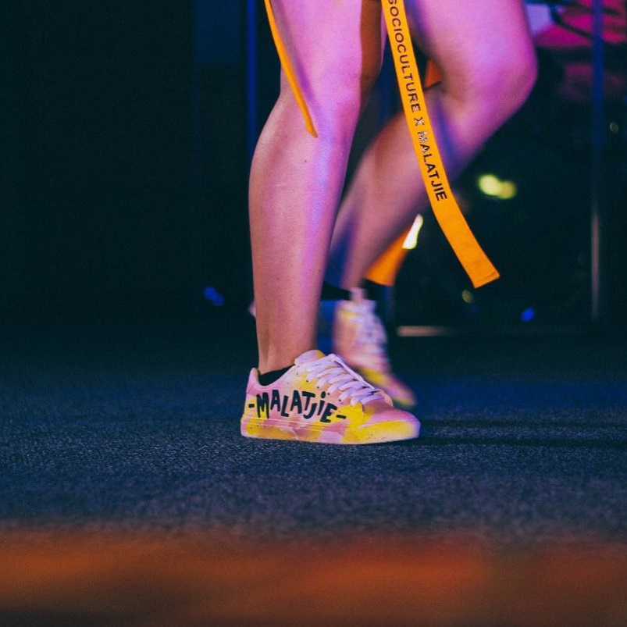
MISSPATTYMONROE @SOCIOCULTURE_BYNAEELAHJUMAT FOR HELPING ME PUT THIS LOOK OUT TO THE WORLD 🌍 AND @MRPFASHION AND FOR THE SHOES @GOODHOPEFM FOR THE DOPE VENUE. THANK YOU 🙏🏼✨💎👑 #CROWNBDAY23 #MALATJIE 👟 📸 : @AWIZY_ODD JANUARY 25, 2018
Analysis Notes: Dressed in opulent sport wear, drawing focus to legs, bust and waist area. Beaming during performance. Curly blonde bob hairstyle.
Caption mentions Mr Price, naeelah jumat, Good Hope FM and includes her #Malatjie hashtag using Cape Town Slang
Emoji’s the globe, hands together, diamond, crown, stars, sneakers, camera to acknowledge photographer

Slide 5
MISSPATTYMONROE MAKING SURE TO PUT THE BEST FOOT FORWARD THIS YEAR, MINITA FOR HALF ASS KAK- BE A DALLA ROT. NEVER GONNA STAAAAAAP🥁🤽🏽‍♀️🤯🧐🧖🏼‍♀️👑🕊🌴🌝🌍✨💦🥑🥦🍯🌠💎 #MAMAMALATJIE #CROWNBDAY23 #VOETE JANUARY 27, 2018
Analysis Notes: Curly blonde hair. Stinkface, kicking and dancing. Dressed in bright orange plush fabric. Drawing attention to legs and waist with protruding fish net. Caption speaks to making a good impression and there is use of Cape Town Slang. Emoji’s crown, peace dove, avocado, diamond, water, stars, honey, globe, palm tree, face with focus lense.

Slide 6
ANALYSIS NOTES: Her performance shows empathy, her hand on her chest seems sincere, audience admiring and tentative, bright light above her head gives off an angelic look and feel. Curly blonde bob. Dressed in see through black net with lingerie or underwear. A gold choker as an accessory. Emoji is an umbrella with rain and camera to acknowledge photographer. Caption is referring to teamwork and her city Cape Town. Makes reference to her hastag #malatjie.
misspattymonroe
When we all come together, the rain ☔️ will fall 📸: @indexfinger88 #malatjie #raindance #camissa #capetown #itsuptous
JANUARY 30, 2018

Slide 7
ANALYSIS NOTES: On stage production. Curly blonde hair being flicked to the side, seems to be dancing. Crop top focus on her waist. Dressed in comfortable casual clothing and combat ankle boots. There is no caption only emoji: red heart, pencil, a person working, camera to acknowledge photographer.
misspattymonroe
🎙🧘🏼‍♂️🧡🧘🏼‍♂️ 📸: @awizy_odd
FEBRUARY 18, 2018

Slide 8
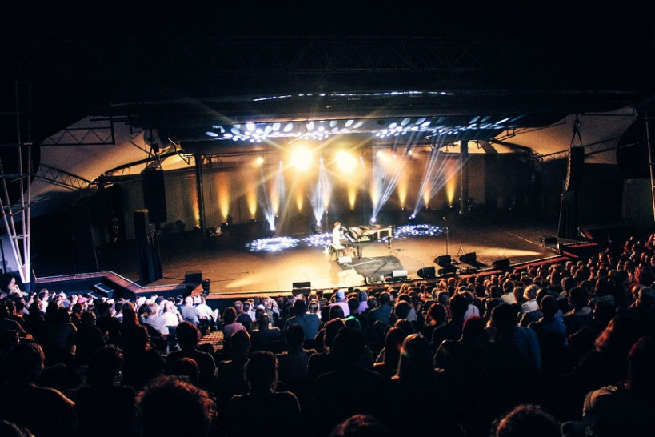
MISSPATTYMONROE THIS DAY WILL BE BURNT INTO MY BRAIN FOR A VERY LONG TIME TO COME. THANK YOU @AMANDAPALMER FOR ALLOWING ME TO BE A PART OF SUCH AN AWESOME SHOW. THE @SPIERWINEFARM AMPHITHEATRE HAS A VERY MAGICAL ENERGY ABOUT IT AND EVERYONE LOVED IT 📸: @AWIZY_ODD FEBRUARY 19, 2018
Analysis Notes: Performing with a piano player. Dancing on a full stage production in an amphitheatre. Dressed in casual clothes. Blonde bob hair. One shot showing from the perspective of a large crowd. Caption expresses gratitude and and acknowledges photographer with a camera emoji. Brand association Spier Wine Farm.

Slide 9
MISSPATTYMONROE LET IT SOAK IN 🧘🏼‍♂️💧🧘🏼‍♂️ #MALATJIE #UNKNOWNUNION 📸 : @AWIZY_ODD FEBRUARY 20, 2018
Analysis Notes: She is making sexy poses, touching her neck. Blonde hair in bob. Performing on dim lit stage. caption let it soak in with emoji of a water droplet and a working person.

Slide 10
MISSPATTYMONROE THANK YOU TO EVERYONE WHO MADE THIS NIGHT POSSIBLE AND TO EACH AND EVERY SOUL THAT CAME THROUGH. YOU GUYS ARE AWESOME ESPECIALLY THE OUENS IN THE PICTURE 😉 @IMCALEBWILLIAMS @JOSHKATTS @VAUGHN.WEBBER @GSUSPECT @MUZEEKCHILD #SSSNS #MALATJIE 📸: @AWIZY_ODD FEBRUARY 26, 2018
Analysis Notes: Performing live with full band and a deejay. Full production with stage lights. She is dressed in a casual cotton short dress, in one of the photos she is crossing her legs in a feminine manner. Emoji a winking face and a camera to refer to photographer. Caption mentions her #malatjie hashtag consistently.

Slide 11
ANALYSIS NOTES: soft pink, purple lighting for the stage, deejay visible in the background. The artist is performing sitting on a bar chair. bra strip is visible on one shoulder. Caption Mercury live, emoji is guitar, clock and piano.
misspattymonroe
MercuryLIVE🎸🥁🎹
FEBRUARY 26, 2018

Slide 12
ANALYSIS NOTES: She is dancing in a provocative manner, mouth open, pulling dress to expose one shoulder. Her legs and thighs are exposed. Dressed in a casual dress, choker and hoop earrings as accessory. Hair in blonde curly bob, the deejay and guitar player in the background. Caption speaks to undressing and not being pressured. Refers to herself as mama in her usual hashtag #malatjie. Emoji on the camera to acknowledge the photographer.
misspattymonroe
“I don’t wanna put no pressure on ya, I just wanna put this blessing on ya, since our last undressing session...” #mamamalatjie 📸 : @awizy_odd
FEBRUARY 27, 2018

Slide 13
MISSPATTYMONROE THANK YOU TO EVERYBODY WHO WAS A PART OF THE #RIELVANHIPHOP. THE CAST IS JUST ON SOME OTHER LEVEL AND I DIDN’T KNOW IF I WAS ABLE TO KEEP UP WITH YOU GUYS BUT THANK YOU FOR THE PATIENCE. THANK YOU TO EVERYONE WHO CAME TO SUPPORT 👘: @SOCIOCULTURE_BYNAEELAHJUMAT 📸: @INDEXFINGER88 #WOORDFEES #MALATJIE #RIELVANHIPHOP #MAMAMALATJIE #THEATER #LIFE #REALSTORIES #KOS MARCH 5, 2018
Analysis Notes: She is dancing with joy, a cast in the background. Bright and trendy feminine luxe sporty wear. Her caption has sincerity and gratitude, thankful to the cast and those who attended the show. The two emoji’s are the dress and camera. refers to Afrikaans language and the festival she was involved in.

Slide 14
ANALYSIS NOTES: Dressed in all black with a touch of white stripes. She is posing in a feminine manner. With a strong gaze and poker face as a doll. One hand resting on table. Waist and thighs exposed for emphasises. Caption includes Cape Town slang and hashtags with #mamamalatjie and #malatjie. Camera emoji to acknowledge photographer.
misspattymonroe
Make sure when you walk into a space , you smaak yourself more than anybody else in the room before you try and chise brasse 📸: @indexfinger88 🇿🇦🇿🇦🇿🇦🇿🇦 #wcw #wce #pieceofmind #firstthingsfirst #mamamalatjie #malatjie
MARCH 7, 2018

Slide 15
ANALYSIS NOTES: Gracefully seated in a feminine way with feet crossed. Red lipstick and bright outfit. Caption in Afrikaans and hastags in Afrikaans pointing out the collaboration with another artist on stage. Mentions the plays name. Emoji camera and face with side mouth.
misspattymonroe
Gaan ma aan jy😏 #Malatjie #stage #socioculture #colab #rielvanhiphop #haakiesdraad 📸: @indexfinger88
MARCH 10, 2018

Slide 16
ANALYSIS NOTES: She is singing with another male artist with the cast in the background. Sneakers and casual relaxed wear exposing legs. The caption has hashtags in Cape Town slang and Afrikaans. Shows her dedication to the cause with a camera emoji for the photographer reference.
misspattymonroe
I do it for the #PITTEKOPPE #BOSSIEKOPPE #malatjies #goemahare 📸 @indexfinger88
MARCH 12, 2018

Slide 17
ANALYSIS NOTES: The photo shows a full moon and movement in her hair and clothes. The exposure of her thighs and booty. Emoji’s siren, erupting volcano and a blue dress
misspattymonroe
Something’s coming 👘🌋🚨 • • • #Malatjie 📸: @awizy_odd
MARCH 13, 2018

Slide 18
ANALYSIS NOTES: She is rehearsing for a performance, dressed in comfortable sneakers, and black and white pants and vest. Leaning comfortably on the mic stand. Her caption is hopeful and with hashtag have faith and #malatjie. Emoji is a camera.
misspattymonroe
Just coz no1’s there yet, doesn’t mean they not coming #havefaith #malatjie 📸 @awizy_odd
MARCH 14, 2018

Slide 19
ANALYSIS NOTES: She is dressed like a doll or lady. High stellittoe, short see through dress all in black. She has a choker on her neck. Legs exposed. Perfoming on a full production stage. Caption refers to legs and blue gums, the use of Afrikaans language is present. Emoji’s camera, blue heart, tongue out and gazing eyeballs.
misspattymonroe
LEGGYBLOUGUMS 💙👅👀 • • • 📸 @indexfinger88
MARCH 15, 2018

Slide 20
ANALYSIS NOTES: Focused on her performance. fishnet stockings in black accentuating her waist. Stink face, eyes shut. Curly blonde hair. Brand affliation is Malatjie branded casual wear clothing. Caption is interactive with her fans. No hashtag, Emoji only a camera for the photographer mention.
misspattymonroe
Don’t take my last ___________ ..... (Fill in the blank) 📸: @shotsbyshimi
MARCH 19, 2018

Slide 21
ANALYSIS NOTES: Performing with a band in the background, dressed in comfortable green pants and long sleeve black top. Blonde curly bob hair. She is standing in one leg forward pose. Caption reminding her followers to watch channel O TV. Camera emoji to mention photographer.
misspattymonroe
Don’t forget to put your reminders on for 16:00 🕓 on Friday @channelotv 📸: @byjono
MARCH 28, 2018

Slide 22
ANALYSIS NOTES: She is dressed in black long sleeved bodysuit, with shimmering top. Long nails, bob blonde curly hair. Facial expression looks content, with eyes closed. Hashtag #RBMFJHB emoji the bullseye.
misspattymonroe
#RBMFJHB 🎯 •••••••••••••••••••••••••••••••••••• 📸 @aust_malema
APRIL 9, 2018

Slide 23
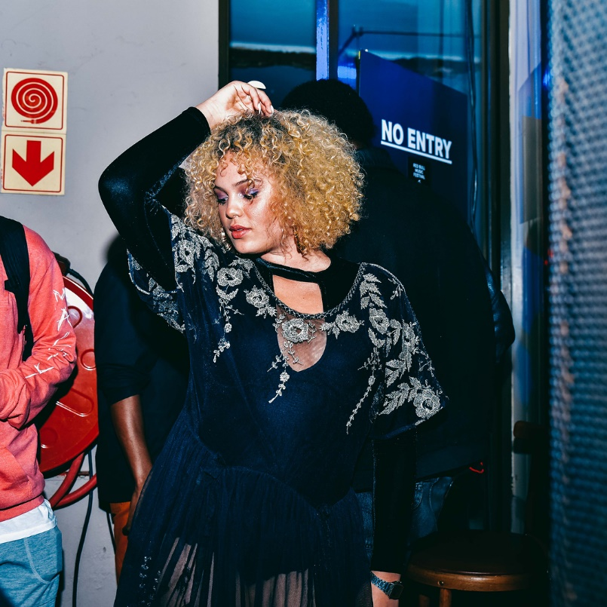
MISSPATTYMONROE #RBMFJHB 🎯♒️♒️♒️♒️♒️♒️♒️♒️♒️♒️♒️ 📸 : @AUST_MALEMA 👗 : @ANNIESWARDROBERENTALS APRIL 10, 2018
Analysis Notes: Brand affiliation Red Bull. She is performing and looks happy, feminine dance moves, open mouth. Dressed in a black and shimmery body suit with tassles. Hair curly and blond bob. Caption bullseye and waves.

Slide 24
MISSPATTYMONROE I’M ALWAYS FROWNING SO MUCH IN MY PERFORMANCES🤨 #RBMFJHB ♒️♒️♒️♒️♒️♒️♒️♒️♒️♒️ 📸 @AUST_MALEMA APRIL 12, 2018
Analysis Notes: She is performing to a crowd, the deejay in the background. Dressed in knee high socks and black and shimmering bodysuit. On the second frame she is giving the crowd a gaze with pouting lips. Blonde curly hair. Her caption refers to her frowning in her performances. Hashtag of the brand affiliate #RBMFJHB Emoji is face lifting one eye and camera to mention the photographer.

Slide 25
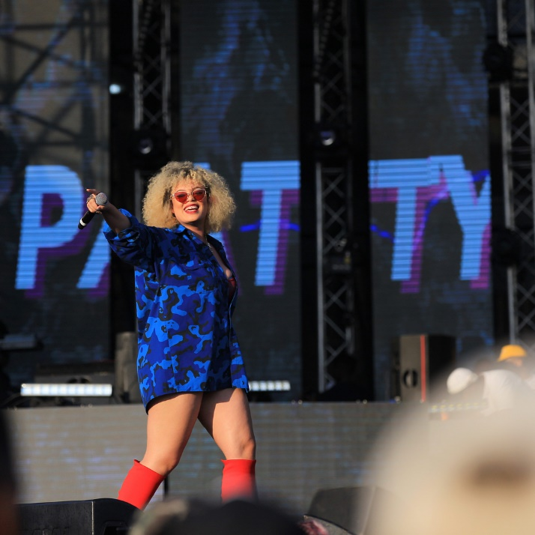
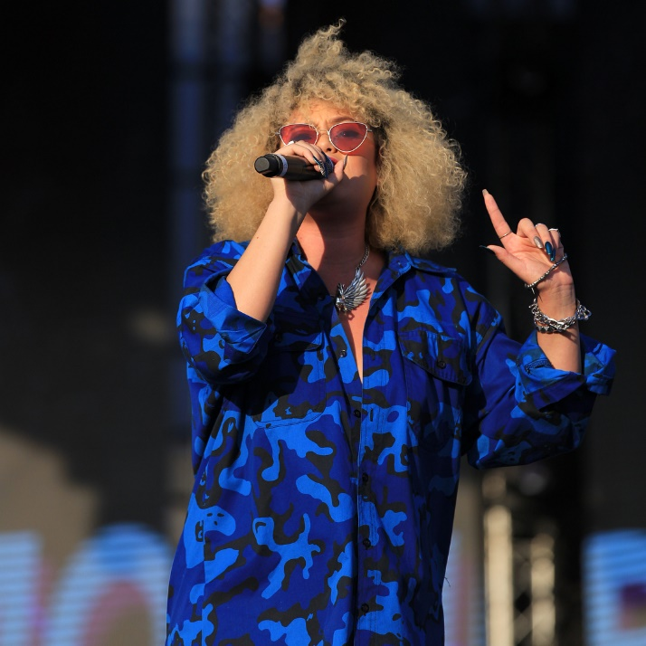
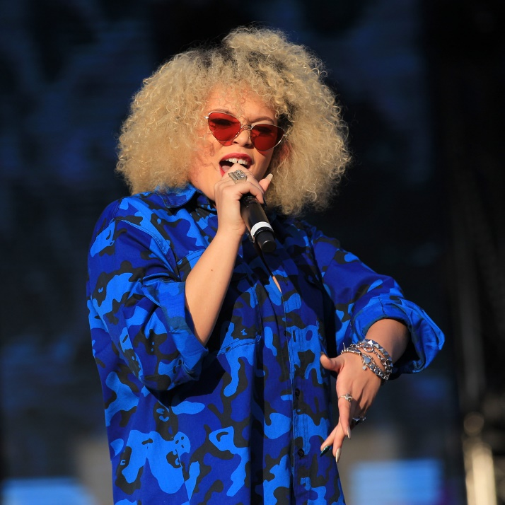
misspattymonroe
BACK TO THE CITY you sexy beast 😈👅 👗 @_lisa_hendricks 🎭🎨 @misskay_sa 📸 @aust_malema #mamamalatjie #malatjieontheloose #bttc2018 #malatjie
APRIL 28, 2018
Analysis Notes: She is dressed in knee high red socks, drawing attention to exposed thighs, camouflage blue long sleeve shirt. Accessories on neck and hands with orange shades. Curly blonde hair and long nails. Looks confident and mesmerizing the crowd. In the caption she refers to herself as a sexy beast, hashtags the festival #bttc2018 and her #malatjie #malatjieontheloose. Emoji’s devil face, tongue out, red dress, the arts, paint holder for artist, camera to acknowledge the photographer.

Slide 26
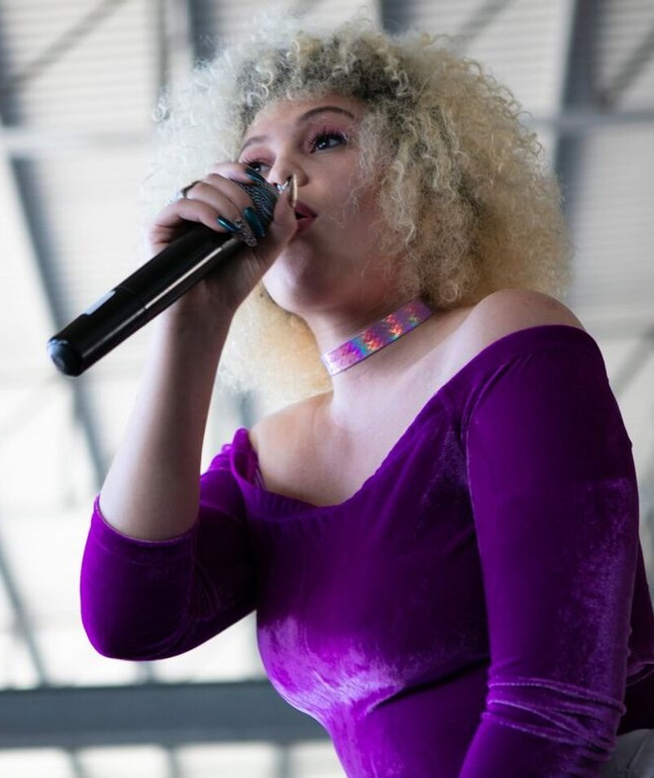
MISSPATTYMONROE SNEAKER EXCHANGE 🔥💗💦🔮 ••••••••••••••••••••••••••••••••• 📸 : @INDEXFINGER88 #MALATJIE #YESIWOREHEELS #IAM #MAMAMALATJIE #INDEXFINGER #SNEAKEREXCHANGE APRIL 30, 2018
Analysis Notes: She is dressed in a velvet purple bodysuit, and bright long dungaree pants, a choker to accessories and boots. She looks in control of her performance, hairstyle in curly blonde bob with a fringe. Caption in capital letters, she highlights that she wore heels to a sneaker event, mentions sneaker exchange the affiliated brand, with hashtags #malatjie, #indexfinger #iam. Emoji’s flame, red heart, water droplets, crystal ball and camera to acknowledge the photographer.

Slide 27
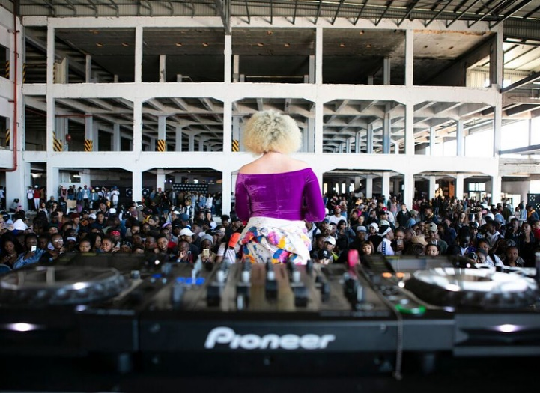
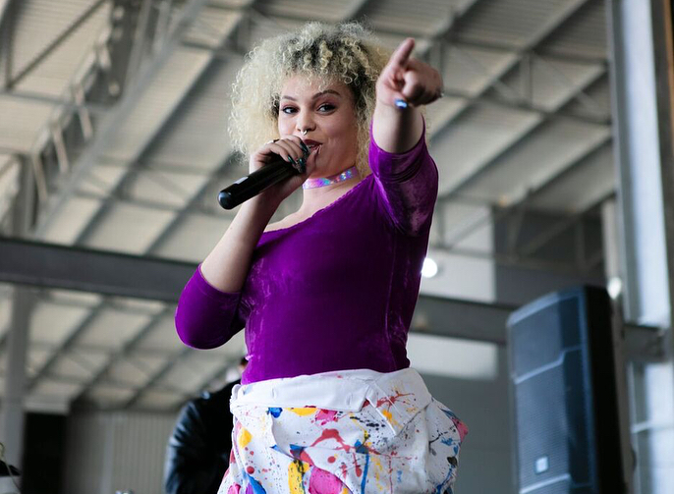
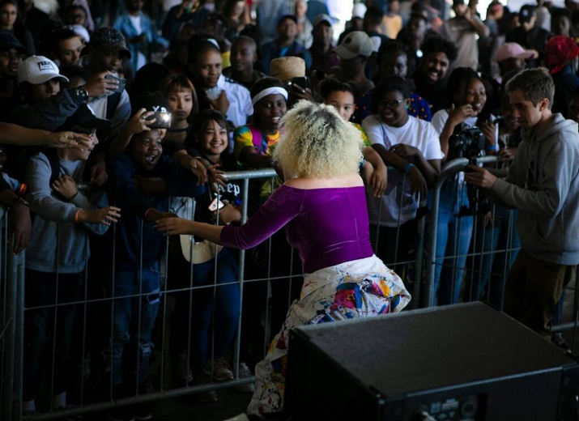
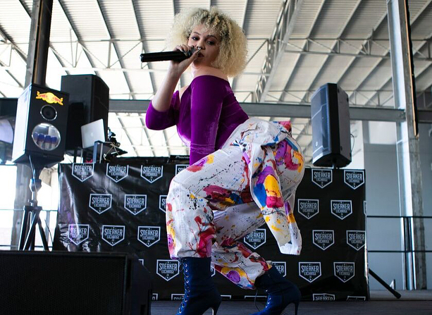
misspattymonroe
The love at sneaker exchange was too lekka, felt abitjie like Justin Boeber 😅😋🙏🏼 💗🔮 ••••••••••••••••••••••••••••• 📸: @indexfinger88
MAY 1, 2018
Analysis Notes: She is performing to a large crowd. This fans reaching out for her hand and taking pictures. On one of the photos it seems she is twerking. She looks self-assured during her performance. Dressed in colourful outfit and high heels. In her caption she is using Cape Town slang and Afrikaans. Happy with the love she received from the crowd. She also mentions the affiliated brand sneaker exchange. Emoji’s Laughing and tongue out face, hands together also known as thank you, red heart, crystal ball and camera to mention photographer.

Slide 28
ANALYSIS NOTES: Necklace, sunglasses, huge dressing ring and dressed in a sporty Puma brand affiliate track pants and jacket open just enough to show cleavage. Fringe on curly blonde bob hair. Caption rhymes and includes hashtags #sneakerexchange, #energyexchange, #malatjie. Emoji’s water, flames and camera to acknowledge photographer.
misspattymonroe
Pull it to the side, let it slide 💦💦💦💦💦💦💦🔥🔥🔥🔥 #sneakerexchange #enegryexchange #malatjie 📸 @thabo_meko16
MAY 7, 2018

Slide 29
ANALYSIS NOTES: She is performing to a crowd that is taking videos and photos in the background. Turquoise Puma brand tracksuit, comfortable clothing. Her dancing is full of energy. Hair movement is clearly visible. Nose and hand ring, choker neck piece. Open mouth which looks like a scream. Caption hashtags are #malatjie, mamamalatjie and the affiliated brand #sneakerexchange making reference to flu and an emoji with a sick , blasts and the camera to mention the photographer.
misspattymonroe
Me keeping this flu 🤒 at bay like 💥💥💥💥💥💥💥💥💥💥💥 📸 @thabo_meko16 #malatjie #sneakerexchange #mamamalatjie
MAY 17, 2018

Slide 30
MISSPATTYMONROE LAST WEEK I GOT THE OPPORTUNITY TO PERFORM AT @UNKNOWNUNION ‘S NEW STORE OPENING IN MABONENG AND I JUST WANNA SAY THANK YOU FOR ALLOWING ME TO BE A PART IT. I’M SO PROUD OF YOU GUYS 📸 @SOSA_SSP APRIL 8, 2019
Analysis Notes: Performing in sizzling red lit room, Hair in African box braid plaits, dressed in a black net top. In the caption thanking the event organiser and mentions a new store opening in Maboneng. There only emoji is the camera to acknowledge photographer.

Slide 31
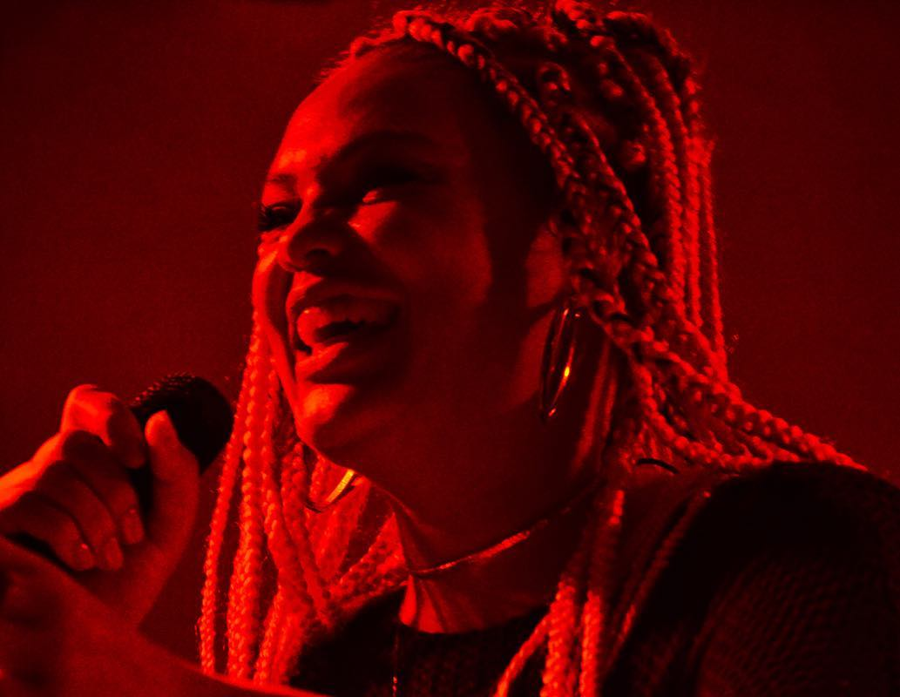
MISSPATTYMONROE WHEN I FIRST CAME FOR SOUND CHECK I WASN’T THE MOST CONFIDENT ABOUT THE SET I WAS GOING TO PERFORM, UNTIL JASON INTRODUCED ME THE NEXT DAY AND I HAD TO GET UP ON STAGE AND SHOW NO FEAR OR ANY SEED OF DOUBT IN MY MIND. LONG STORY SHORT- BY THE END OF MY SET I DIDN’T WANNA LEAVE. IT’S A BLESSING TO BE A REFLECTION IN THIS WORLD 🌍 AND I GIVE THANKS I STILL HAVE THE OPPORTUNITY TO DO IT 📸 @SOSA_SSP APRIL 10, 2019
Analysis Notes: There is a gaze in her eyes, and big smile. Hair in African box braids plait. Big hoop earrings and a choker. She looks creative, innocent and happy. Caption all in capital letters, it is describing how she overcame her fear and self doubt. Emoji’s the globe/world and camera to acknowledge photographer.

Slide 32
ANALYSIS NOTES: She looks well groomed, long Eyelashes, blonde African block plaited braids, Dressed in a black see through outfit with diamante details and frills or ruffles. She is performing on a fashion show ramp. Her caption is referring to other woman. Emoji’s red dress as reference to stylist and camera to mention the photographer. Used hashtag #bbim2019 and mentions the event name.
misspattymonroe
“All dem other woman, they were practice “ -Fill Ya Cup 👗 by @denzilpillay703 📸 @roelse_portraits Occasion @you_are_phenomenal_ #bbim2019
MAY 28, 2019

Slide 33
ANALYSIS NOTES: Outfit with raffles and diamante shiny details. Long African blonde braids. Full make up and ankle boots. Her performance looks sensual and smooth. Caption space cowgirl and emoji’s a rocket and a cowboy.
misspattymonroe
Space cowgirl 🚀 🤠
MAY 30, 2019

Slide 34
MISSPATTYMONROE MUSIC ALLOWS ME TO WORK WITH A LOT DIFFERENT PEOPLE , MEETING THESE WOMEN TEACH ME VARIOUS LESSONS BUT ONE THING REMAINS CONSTANT. WHERE WOULD WOULD WE BE WITHOUT MUSIC 🎶 CHECK THE LINK TO THE VIDEO ON MY STORIES #ROLANDPOWERWOMEN #LIVEMUSIC #UNKNOWNUNION #PATTYMONROE #MALATJIEONTHELOOSE #MALATJIE AUGUST 9, 2019
Analysis Notes: Performing with an all female band, beautiful lighting. Curly short hair. Dressed in a long coat. Caption in capital letters, directs followers to watch the video. Hashtags mentions the band, event and her brand. Emoji musical note.

Slide 35
ANALYSIS NOTES: The strong gaze in her eyes to the crowd. Hairstyle in curly bob, shades, bracelet and neck piece with pearls. She looks sophisticated and serious. Caption refers to pushing boundaries and fighting or taking charge of your destiny instead of waiting for permission. Emoji boxing gloves and camera for photographer.
misspattymonroe
The question isn’t Who’s gonna let me; it’s who the hell gonna stop me🥊🥊🥊 📸 @anelia_loubser
AUGUST 12, 2019

Slide 36
ANALYSIS NOTES: Performing on full production large stage in collaboration with another male artist. She is dressed in comfortable tracksuit pants, sneakers, choker, big hoop earrings and tank top. Orange curly bob hair swaying. Her caption has a sense of humour by referring to her self as not being sure where she is going but it feeling right. Hashtags are positive such as #Queen #lovemyjob #performer and their are self affirming, 4th Street Wines brand affiliation. Emoji laughing faces and camera.
misspattymonroe
That time when you not really sure where you going but it feels right 😂😂😂 Just keep swimming my malatjies 📸 @awizy_odd #pattymonroe #malatjieontheloose #ilovemyjob #performer #khoisan #queen #go4th #speedsta #4thstreetwines #go4thandconnect
OCTOBER 2, 2019

Slide 37
MISSPATTYMONROE WE COMMING WITH THE BIG VIBE 😏 #GO4TH OCTOBER 7,2019
Analysis Notes: She looks focused, in the moment and owning her performing space with the shared collaboration with the male artist. Orange curly hair, eyelashes, choker, long nails, hoop earrings, tank top and comfortable tracksuit pants. Emoji is a face looking to the side. Caption is in capital letters and refers to high energy by saying we coming with the big vibe.

