Slide 1
FIGURE 2 @NADIANAKAI: Femme fatale (Maneater) Exclamation marks AGE: 29 POSTS: 10k FOLLOWERS: 1.4M FOLLOWING: 1645 DECEMBER 2017-DECEMBER 2019
Mpho Roberta Masondo 219067228
Supervisor: Prof. Nic Theo
Master of Technology:
Public Relations Management
Faculty of Informatics and Design

Slide 2
ANALYSIS NOTES: Performing in a club with the deejay visible in the background. Body art on arm. She has makeup, long wig and long nails on. Dressed in a t-shirt dress, shades and a cap from her fashion line branded with her stage name Bragga. Caption mentions Onyx Sandton club, right now includes red exclamation marks as emojis and a camera to credit the photographer.
nadianakaiVerified
@onyx_sandton riiiiiight now‼️‼️‼️ 📷 @riaaz420
DECEMBER 1, 2017

Slide 3
ANALYSIS NOTES: Makeup, long nails on and long curly wig with hair pushed on one side. Branded cap from her fashion line, branded shades from designer brand and wearing a t-shirt dress. Performing with the deejay visible in the background inside a club. Caption: She refers to herself as a queen, out at Onyx in Sandton club also mentioned in the caption is the brand affiliated with the shades @luxottica. Emojis: Crown, Exclamation marks and camera to credit photographer.
nadianakaiVerified
Queen out at @onyx_sandton 👑‼️📷 @riaaz420 shades from @Luxottica
DECEMBER 1, 2017

Slide 4
ANALYSIS NOTES: She is posing with both hands on her hips, while gazing at the crowd. Dressed in glittering costume knee length boots, stockings, underwear and long sleeve crop top. Exposing her waist, hips and thighs. Has on a long waist length blonde wig, heavy makeup with eyelashes extensions and long nails. Caption: congratulates Refiloe the male artist she is performing with on stage. Hashtags the name of the festival #fillupfnbstadium. Emojis: Exclamation marks and a camera to credit photographer.
nadianakaiVerified
Congratulations Refiloe! You did it‼️‼️ #Fillupfnbstadium 📷 @urbankreativesa
DECEMBER 3, 2017

Slide 5
ANALYSIS NOTES: Performing on a big production stage with a male artist in the background. Blonde waist length wig on, heavy makeup, long nails. Dressed in sparkling knee length boots, stockings, underwear and long sleeve crop top. Hips, thighs and waist exposed. The words used on the caption are positive, shows gratitude and congratulates the fellow artist on their accomplishment on the hip hop music industry. Hashtags the name of the event #fillupfnbstadium and there are exclamation mark emojis.
nadianakaiVerified
Woke up still in disbelief of last night! Feels LIKE a dream! The energy was soo amazing!!! And Cass's show was sooooo impressive! The massive lions gave me goosebumps!!! I'm so grateful I got to be a part of such a BIG moment for HipHop and our music industry as a whole! Every year I get more and more inspired to never let my dreams go‼️‼️‼️ no amount of haters in and out of the industry will ever derail me from my dream and what I work hard towards! Last night was game changing!!!! YOU did that! I'm SOOO inspired! Congratulations Bro! #fillupfnbstadium
DECEMBER 3, 2017

Slide 6
ANALYSIS NOTES: She is dancing in a squat position on stage with the deejay visible in the background. Wearing a cap, shades, orange long sleeve sweater, jeans and heals. Has on long blonde wig, makeup and nails. Caption: laugh out loud, I thought i was Babes last night at Pop bottles is the event name. Only has a camera emoji to credit the photographer.
nadianakaiVerified
Lol! I thought I was Babes last night at Pop bottles!!!! 📷 @urbankreativesa
DECEMBER 4, 2017

Slide 7
ANALYSIS NOTES: Dancing in a squat position on stage. Wearing sparkling long sleeve crop top, underwear, stockings and high heel knee length boots. Exposing her waist, hips and thighs. Wig, heavy makeup with eyelashes extension and long nails on. In the caption there is a hashtag of the event #fillupfnbstadium, she also writes “you did the damn thing” with exclamation marks, giving praise and acknowledging the costume designer @onitaferreiradesigns
nadianakaiVerified
@anitaferreiradesigns you did the damn thing!!!!!!! #fillupfnbstadium
DECEMBER 4, 2017

Slide 8
ANALYSIS NOTES: Performing on a full production stage, lights, smoke machines, audio visuals, with background dancers and a large audience looking on. Caption Top Shayela makes reference to African hip hop slang. Hashtags the event #fillupfnbstadium. Camera emoji to acknowledge photographer
nadianakaiVerified
Top Shayela!!!!! #fillupfnbstadium 📷 @jabukiing
DECEMBER 5, 2017

Slide 9
ANALYSIS NOTES: Performing on stage in a squat position with one hand between her thighs. Dressed in a costume exposing her waist, hips and thighs. Long blonde wig, long nails and eyelashes. Stockings, knee length boots, underwear and long sleeve crop top glittering. Caption: A moment i’ll remember for the rest of my life, exclamation mark is used. Event name as a hashtag and she says it was magical. The only emoji is a camera to credit photographer.
nadianakaiVerified
A moment I'll remember for the rest of my life! #fillupfnbstadium was magical! 📷 @trevor_zondi
DECEMBER 5, 2017

Slide 10
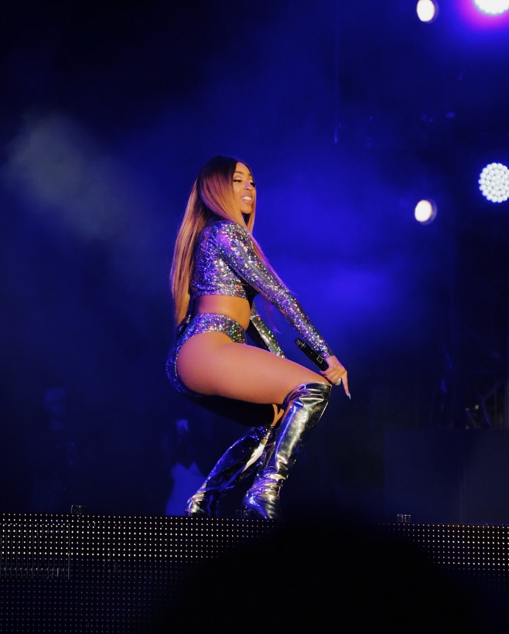
NADIANAKAIVERIFIED ⭐️📷 @TREVOR_ZONDI DECEMBER 6, 2017
Analysis Notes: Exposing her waist, hips and thighs, wearing a glittering outfit, heavy makeup, long blonde wig, stockings and knee length boots. Squat or twerking position during her position. In the the other image she is gazing at the audience. Emojis Star and camera to credit photographer for taking the image.

Slide 11
ANALYSIS NOTES: Performing in a squat position. She has on a long wig, shades, nails, a g-string bodysuit, stockings and knee length boots. Draws focus to her buttocks, boobs, hips and thighs. The image is black and white to create drama. Caption mentions that it was super in her second home, with exclamation marks, the event name was @maftownheights. Flame and camera emojis, photographer acknowledged
nadianakaiVerified
@maftownheights was SUPER 🔥🔥 in my second home! 📷 @adventuresofdashscout
DECEMBER 8, 2017

Slide 12
ANALYSIS NOTES: Bright pink knee length boots and an orange bodysuit. Legs wide open pose. Long wig, shades, makeup and stockings. The deejay is visible in the background during her performance. The caption is the event name Maftown heights. Flame and camera emojis to credit photographer.
nadianakaiVerified
Maftown Heights🔥🔥🔥🔥 📷 @onair_ent
DECEMBER 9, 2017

Slide 13
ANALYSIS NOTES: Performing on a large production stage with one hand on her waist. Dressed in a glittering black crop top and black tracksuit pants, wig and shades on. Caption: Last night was amazing, exclamation marks, congratulates the artist @Kwestadakar for his song spirit going platinum. Hashtags, she refers to herself as a queen, also mentions her song name #NaaaMeean. Emojis: Exclamation marks, thank you or praying hands and a camera to credit photographer.
nadianakaiVerified
Last night was amazing!!!!!! Congratulations @kwestadakar ‼️‼️‼️‼️‼️🙏🏽🙏🏽🙏🏽🙏🏽 📷 @aust_malema #Queen #NaaaMeean #spiritgoesplatinum
DECEMBER 11, 2017

Slide 14
ANALYSIS NOTES: On a big production stage with screens, visuals, lights and smoke machines. She is posing while at the same time gazing at the audience. Dressed in black tracksuit pants and a glittering crop top exposing her waist. Long wig and black shades on. Caption: Cinderella to these hoes, uses vulgar and an exclamation mark to stress her point. Hashtags: The venue #Zone6, the other artists song #spirit, She refers to herself as a #queen, Mentions her song #NaaaMeean. Camera emoji to credit photographer.
nadianakaiVerified
Cinderella to these hoes! 📷 @aust_malema #Zone6 #spirit #Queen #NaaaMeean
DECEMBER 11, 2017

Slide 15
ANALYSIS NOTES: Orange beam lights in the background. She’s performing on a big production stage. In a squat position wearing a glittering black crop top and tracksuit pants, a long wig, makeup and black shades. Caption: zoning in capital letters. Camera emoji to credit photographer.
nadianakaiVerified
ZONING 📷 @aust_malema
DECEMBER 11, 2017

Slide 16
ANALYSIS NOTES: The deejay is visible in the background. Orange beam lights on stage. The artist has both arms up in the air during her performance. Dressed in a black crop top and tracksuit pants, black wig and shades. The audience is watching and taking videos/photos with their phones. Caption is in capital letters: Feed life into your life, Emojis: exclamation marks and camera to credit photographer.
nadianakaiVerified
FEED LIFE INTO YOUR LIFE‼️ 📷 @aust_malema
DECEMBER 11, 2017

Slide 17
ANALYSIS NOTES: She is performing at Icon club with another male artist, orange beam lights in the background. Dressed in a black sports bra and tracksuit pants. Has on a long wig with a fringe, eyelashes and bracelet. The words in the caption: Last night at Icon, exclamation marks, get my new single Naaa Meean now, exclamation mark, clicable link in my bio, exclamation mark. Hashtag: #CassperBirthday. Camera emoji to credit photographer.
nadianakaiVerified
Last night at Icon!!!!! #CassperBirthday get my new single Naaa Meean now! Clickable link in my bio! 📷 @jabukiing
DECEMBER 16, 2017

Slide 18
ANALYSIS NOTES: Performing on stage, long wig, makeup, extension eyelashes, bracelet accessory and clothed in a glittering basketball vest. Exposing her back, arms and legs. Words on caption: Hey Kimberley, you were soooo much fun BTW (By The Way) Exclamation marks. Camera emoji to credit photographer.
nadianakaiVerified
Hey Kimberley, you were soooo much fun BTW!!!!!! 📷 @jabukiing
DECEMBER 26, 2017

Slide 19
ANALYSIS NOTES: Performing facing a large crowd who are taking photos/videos of the artist. She is posing during her performance. Has on a long blonde wig, comfortable outfit and sneakers. Words in the caption: All of da LIGHTS in capital letters, followed by exclamation marks. Camera emoji to acknowledge photographer.
nadianakaiVerified
All of da LIGHTS!!!! 📷 @jabukiing
DECEMBER 26, 2017

Slide 20
ANALYSIS NOTES: Performing on stage to a large audience, taking photos/videos of the artist. Dressed in a bodysuit, chrome hooded bomber jacket and ankle boots with stiletto heel. Caption mentions the Thaba Nchu area and the words Light it up, ZA for South Africa. Hashtags the name of the event: #webackhomefest. Emoji Exclamation marks.
nadianakaiVerified
Light it up‼️‼️‼️‼️‼️ Thaba Nchu‼️‼️‼️ #webackhomefest 🇿🇦
DECEMBER 27, 2017

Slide 21
ANALYSIS NOTES: Performing on stage with other male artists, hands in the air. Dressed in a orange bodysuit, a cap, purple wig, accessory belt and thigh high heel boots. Caption: Mood all December, followed by exclamation marks. Emojis: Exclamation marks and camera to credit photographer.
nadianakaiVerified
Mood All December ‼️‼️‼️‼️ 📷 @jabukiing
DECEMBER 28, 2017

Slide 22
ANALYSIS NOTES: Gazing at the audience during her performance. Has a blonde wig on, crop top with glitter and black underwear, exposing her hips and thighs. Caption: We Back Home Fest, Emoji: Exclamation marks.
nadianakaiVerified
WeBackHomeFest‼️
DECEMBER 28, 2017

Slide 23
ANALYSIS NOTES: Dressed in white bodysuit with tassel details, wig, shades, choker, bracelet, accessory around her hips, stockings and stiletto heel ankle boots. Has makeup on with Red lipstick. Caption has a hashtag #joburgnye18 Emoji number eight.
nadianakaiVerified
♉️ #joburgnye18
JANUARY 1, 2018

Slide 24
ANALYSIS NOTES: Walking on stage with microphone in her hand. Hair plaited in bright long African box braids. Wearing ski goggles, a long sleeve mesh fabric black bodysuit with glitter on shoulders. Exposing her cleavage, hips and legs. Caption: Show time. Emoji: Exclamation marks
nadianakaiVerified
Show time‼️‼️‼️‼️‼️‼️‼️
JANUARY 6, 2018

Slide 25
ANALYSIS NOTES: Reaching out to her fans. Dressed in a long sleeve mesh fabric bodysuit. Hair in colourful long African braids. Manager or Bodyguard trying to pull her away from fans. Caption: Laugh out loud, exclamation mark, I think i stress my Road Manager out, exclamation mark. Hashtag #firstFriday. Emoji: Laughing face with tears.
nadianakaiVerified
Lol!!!!! I think I stress my Road Manager out! 😂 #FirstFriday
JANUARY 6, 2018

Slide 26
ANALYSIS NOTES: She is performing at a club. Her long wig has a green tint with white. Accessories: watch, shades and ring. Dressed in a bodysuit, stockings and bumshorts. Deejay visible in the background. Caption: Last night at Harem, exclamation marks. Camera emoji to credit photographer.
nadianakaiVerified
Last night at Harem!!!!! 📷 @lashshots
JANUARY 21, 2018

Slide 27
ANALYSIS NOTES: Sparkling watch and shades. Long white wig and long nails. She is performing at a club. Caption informs her followers that the music video to her single Naaa Meean is on the way. Exclamation mark emojis.
nadianakaiVerified
Naaa Meean music video on the way ‼️‼️‼️
JANUARY 21, 2018

Slide 28
ANALYSIS NOTES: Deejay is clearly visible in the background. The artist name and portrait is projected on the screen on stage. Dressed in a back bodysuit and bumshorts, turquoise long wig and eyelashes. Performing to an audience. Caption: It was epic, launching my music video at the hashtags event #barcardihousepartysessions, There is no emoji used.
nadianakaiVerified
Launching my music video at the #bacardihousepartysessions was epic!!!!!
JANUARY 26, 2018

Slide 29
ANALYSIS NOTES: Posing during her performance. Castlelite brand affiliate in the background. She is dressed in a white bodysuit with flower details and black pants. Blue long wig, makeup and shades. Caption: I’m one of the artist that got unlocked last night alongside @frankcasino, @shane_eagle and we will be opening acts for @chancetherapper, you ready for April 30th! Emojis: exclamation marks, snowflake, camera to credit photographer.
nadianakaiVerified
I'm one of the artist that got unlocked last night alongside @frankcasino and @shane_eagle we will be opening acts for @chancetherapper ‼️‼️ you ready for April 30th! ❄️ 📷 @lashshots
JANUARY 31, 2018

Slide 30
ANALYSIS NOTES: Heavy makeup, turquoise long wig and nails. Glittering choker, shades and watch. Dressed in white mesh fabric bodysuit and long black pants. Posing with a serious face. No caption only snowflake emoji.
nadianakaiVerified
❄️
FEBRUARY 1, 2018

Slide 31
ANALYSIS NOTES: Dancing during her performance. Big smile on her face with makeup on. Choker on her neck. Turquoise long wig and nails. Dressed in a white mesh and net fabric oversized t-shirt, Ivy Park brand affiliate. Body art visible on her arm. Caption in capital letters MOOD. Camera emoji to credit photographer.
nadianakaiVerified
MOOD! 📷 @lashshots
FEBRUARY 4, 2018

Slide 32
ANALYSIS NOTES: Gazing into the audience during her performance. Turquoise long wig, makeup, eyelashes and nails. choker and watch accessories. Body art visible on arm. Orange sports bra and black underwear with lime mesh see through fabric. Caption: The hashtaged event #BarcardiHolidayclub was something not meant to be missed! It was such a vibe, Exclamation mark. Jeeezzzzzz Exclamation mark. Emoji: Camera to credit photographer.
nadianakaiVerified
The #BacardiHolidayclub was something not meant to be missed! It was such a vibe! Jeeezzzzz! 📷 @lashshots
FEBRUARY 5, 2018

Slide 33
ANALYSIS NOTES: Big smile on artists face, performing on stage with a fan taking a photo/video. Turquoise and purple long wig, nails, heavy makeup, eyelashes extensions and a bling watch. White oversized t-shirt and white underwear. Caption: Heeeeey Guuurrrrl, Exclamation mark. There is no emoji.
nadianakaiVerified
Heeeeey Guuurrrrl!
FEBRUARY 5, 2018

Slide 34
ANALYSIS NOTES: Performing with a live band. Gold chain, bracelet, watch, ring ccessories, Wig and makeup on. Dressed in black tank top, denim shorts and black ankle boots. Caption: Feel Good Live Sessions. Camera Emoji to credit photographer.
nadianakaiVerified
Feel Good Live Sessions 📷 @lashshots
FEBRUARY 12, 2018

Slide 35
ANALYSIS NOTES: Performing with a live band in the background. Dressed in a tank top and shorts. Gun hand gesture. Caption mentions the event name: Feel Good Live Sessions. Camera Emoji.
nadianakaiVerified
Feel Good Live Sessions 📷 @lashshots
FEBRUARY 12, 2018

Slide 36
ANALYSIS NOTES: The artist is performing with another male artist holding glasses with drinks for brand affiliation. Caption mentions Feel Good Live Sessions. Emoji: Camera to credit photographer.
nadianakaiVerified
Feel Good Live Sessions 📷 @lashshots
FEBRUARY 12, 2018

Slide 37
ANALYSIS NOTES: She is performing, wearing a beret hat, shades, long sleeve top and long pants. Caption: Welcome to the Pink room, exclamation mark, in all black, exclamation mark. Camera emoji to credit photographer.
nadianakaiVerified
Welcome to The Pink room! In all black! 📷 @lashshots
FEBRUARY 18, 2018

Slide 38
ANALYSIS NOTES: There is no emoji or caption accompanying this black and white image. She is performing in a club with the deejay in the background. The logo of the club Icon is on the ceiling. Hennessy brand affiliation visible in the background. The artist is wearing a sports bra and tight pants. Long wig, makeup and body art visible.
FEBRUARY 25, 2018

Slide 39
ANALYSIS NOTES: Performing to an audience. She is making a gun hand gesture. Curly long black wig and makeup on. Dressed in glittering stiletto heel boots and a branded Ivy Park tracksuit set. Caption: Braam was sooooo lit last night, exclamation marks. Camera emoji.
nadianakaiVerified
Braam was sooooo lit last night!!!!!!!! 📸 @lashshots
MARCH 3, 2018

Slide 40
ANALYSIS NOTES: Makeup and long black curly wig on. Choker accessory. Dressed in a branded Ivy Park tracksuit. There is no caption. Diamond emoji.
nadianakaiVerified
💎
MARCH 3, 2018

Slide 41
ANALYSIS NOTES: Performing and dancing to an audience. Turquoise and purple long wig. Dressed in a black tank top and tights. Caption: Its ALWAYS a good time, exclamation mark. Camera emoji to credit photographer.
nadianakaiVerified
It's ALWAYS a good time! 📸 @lashshots
MARCH 4, 2018

Slide 42
ANALYSIS NOTES: Turquoise and purple long wig. Dressed in a casual comfortable outfit. Makeup and eyelashes on. Interacting and performing for audience. Caption: All Love. Red heart emoji.
nadianakaiVerified
All Love ❤️
MARCH 4, 2018

Slide 43
ANALYSIS NOTES: Trace Brand affiliation. The artist is performing to a large excited audience. No caption. Red heart and camera emoji.
nadianakaiVerified
❤️ 📸 @lashshots
MARCH 4, 2018

Slide 44
ANALYSIS NOTES: Heavy makeup, long wig, dressed in a bikini top. Bracelet and visible body art. Caption: Saucy. Emoji: Camera to credit photographer.
nadianakaiVerified
.Saucy. 📸 @lashshots
MARCH 5, 2018

Slide 45
ANALYSIS NOTES: Heavy make up and long turquoise and purple wig. Bikini top brings focus to cleavage. The artist is performing while giving the audience a gaze. Ciroc brand affiliation. Body art and bracelet visible. Caption: Trust me, I’m working…. Emoji: Camera to credit photographer.
nadianakaiVerified
Trust me, I'm working.... 📸 @lashshots
MARCH 5, 2018

Slide 46
ANALYSIS NOTES: Bob wig under her own brand Bragga cap. Star body art visible on her back. The artist looks engaged and focused. Caption: You get out, what you put in, exclamation mark, Hope you had a Blessed Sunday, exclamation mark. Emoji: camera to credit photographer.
nadianakaiVerified
You get out, what you put in! Hope you had a Blessed Sunday! 📸 @lashshots
MARCH 11, 2018

Slide 47
ANALYSIS NOTES: Bob cut wig, casual outfit cargo pants, sweater wrapped around her waist and tank top. It looks like she is having a rehearsal. Caption: Explaining the vision, exclamation marks. Emoji: Camera to credit photographer.
nadianakaiVerified
Explaining the vision!!!!!!!! 📸 @lashshots
MARCH 12, 2018

Slide 48
ANALYSIS NOTES: Leaning towards her audience during her performance. Her hair is in colourful African braided blocks. She is dressed in a white bikini set and crome knee length boots. Caption: Yo! 5 more days to go till Major League Gardens, exclamation marks, I hope you got your all white fit ready, exclamation marks. Diamonds emoji
nadianakaiVerified
Yo! 5 more days to go till Major League Gardens!!!!! I hope you got your all white fit ready!!!!!! 💎💎💎💎💎💎💎💎💎💎💎💎💎
MARCH 12, 2018

Slide 49
NADIANAKAIVERIFIED ALL WHITE INSPIRATION!!! #MAJORLEAGUEGARDENS THIS WEEKEND!!!!!!!! GET YOUR TICKETS!!! 👀💎💎💎👀 MARCH 12, 2018
Analysis Notes: She posted two different images of her in an all white outfit to set an example for her followers attending the event. Caption in capital letters instructing followers to go buy tickets #majorleaguegardens event. ALL WHITE INSPIRATION, EXCLAMATION MARKS. THIS WEEKEND, EXCLAMATION MARKS. GET YOUR TICKETS, EXCLAMATION MARKS. Emoji’s side eye and diamonds.

Slide 50
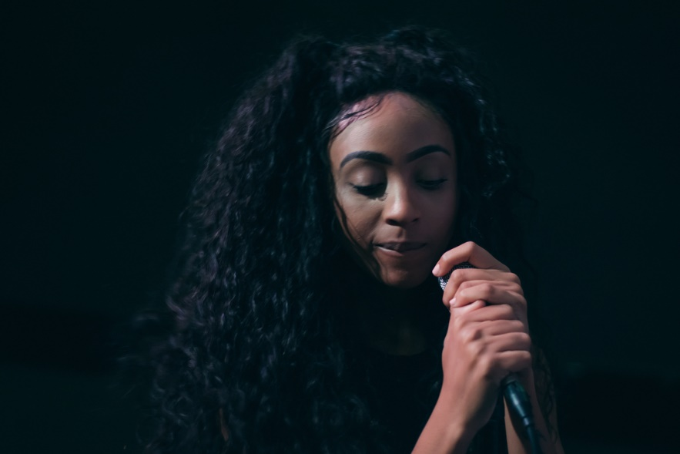
NADIANAKAIVERIFIED #PLAYHARDWORKHARDER WORKING HARD TRYNA GET THIS SHOW TOGETHER!!!!!!!! 🙏🏽 📸 @LASHSHOTS MARCH 16, 2018
Analysis Notes: The artist looks like she is rehearsing. Long black curly wig on her head. Caption in capital letter and consists of exclamation marks. WORKING HARD TRYNA GET THIS SHOW TOGETHER. Hastag: #PLAYHARDWORKHARDER. Emoji: camera to acknowledge photographer.

Slide 51
ANALYSIS NOTES: The artist is performing to a crowd with the deejay in the background. Long black wig and shades on. No caption. Camera emoji to credit photographer.
nadianakaiVerified 📸 @lashshots
MARCH 20, 2018

Slide 52
ANALYSIS NOTES: Artist performing with a gun hand gesture. Long black wig and heavy makeup on. Wearing shorts and a black tank top. Caption: Last. Night. Camera emoji to credit photographer.
nadianakaiVerified
Last. Night 📸 @lashshots
MARCH 26, 2018

Slide 53
ANALYSIS NOTES: Performing and interacting with audience in squat position. Long black wig on, tank top, shorts and knee length stiletto heel boots. Caption: Last night was lit, exclamation marks. Camera emoji to credit photographer.
nadianakaiVerified
Last night was lit!!!! 📸 @lashshots
MARCH 26, 2018

Slide 54
ANALYSIS NOTES: Artist intimately performing to the audience. Caption: Last night was special, exclamation mark. Emojis: stars and camera to credit photographer.
nadianakaiVerified
Last night was special!!!!!!! 💫 📷 @lashshots
MARCH 31, 2018

Slide 55
ANALYSIS NOTES: The artist is performing to a happy crowd. She is wearing a g-string bodysuit with transparent spandex. Long white and turquoise wig on. Caption: Rocking. Emojis: Exclamation marks and camera to credit photographer.
nadianakaiVerified
Rocking ‼️📷 @lashshots
MARCH 31, 2018

Slide 56
ANALYSIS NOTES: The artist is performing on stage, exposing her waist, hips and thighs. Wearing a cap and long wig, a long sleeve crop top and matching underwear, sparkling stiletto heel ankle boots. The audience is interacting with her. There is no caption only to the top emojis.
nadianakaiVerified
🔝🔝🔝🔝🔝🔝🔝🔝
APRIL 1, 2018

Slide 57
ANALYSIS NOTES: Performing and stretching out the microphone to the audience. Stage lights visible in the background. The artist is gazing at the crowd with her mouth open. Dressed in a two piece, long wig and a cap. Exposing her cleavage, waist and thighs. Caption: Never let success get to your head, never let failure get to your heart… No emoji.
nadianakaiVerified
Never let success get to your head, never let failure get to your heart...
APRIL 1, 2018

Slide 58
ANALYSIS NOTES: The artist is leaning towards her audience during her performance, the photographer decided to focus on her buttocks in the short. She is dressed in tracksuit pants, tank top and a cap. With a long wig on. No caption. Camera emoji to credit the photographer.
nadianakaiVerified
📷 @lashshots
APRIL 7, 2018

Slide 59
ANALYSIS NOTES: Performing to the crowd while stretching the microphone out to the audience to sing along. No caption. To the top emojis.
nadianakaiVerified
🔝🔝🔝🔝
APRIL 7, 2018

Slide 60
ANALYSIS NOTES: Stadium bright spotlights in the background. The artist is performing to a large audience and leaning towards them. The stage floor looks wet. This image is black and white. Caption: A river cuts through a rock NOT because of its power, but its PERSISTENCE, exclamation marks. Camera emoji to acknowledge the photographer.
nadianakaiVerified
A river cuts through a rock NOT because of its power, but its PERSISTENCE!!!! 📷 @lashshots
APRIL 9, 2018

Slide 61
ANALYSIS NOTES: The artist is posing on stage. Long elbow length wig, heavy makeup and long eyelashes on. Long sleeve crop top and black underwear with see through mesh pants. No caption. Camera emoji to credit photographer.
nadianakaiVerified
📷 @lashshots
APRIL 9, 2018

Slide 62
ANALYSIS NOTES: The artist is wearing a bodysuit with a military long black coat, knee high stiletto heel boots and a waist bag. Long wig and heavy makeup. She is surrounded by models performing on a ramp for the fashion show, her one hand is making a gun point gesture. Caption: Last night was soooo much fun, exclamation mark. Black Label brand affiliation. Hashtag: #SAFW18 and #hospicewitsnwts18. Camera emoji to credit photographer.
nadianakaiVerified
Last night was soooo much fun!!!!! #SAFW18 #hospicewitsnwts18 📷 @lashshots
APRIL 16, 2018

Slide 63
ANALYSIS NOTES: She is performing on a fashion ramp. Caption in capital letters WORK, then mentions @nicole_bessick. Emoji: Exclamation marks.
nadianakaiVerified
WORK @nicole_bessick ‼️
APRIL 16, 2018

Slide 64
ANALYSIS NOTES: Black Label Brand affiliation. The artist is performing with fashion models following her. Caption: Juicy. Emoji: Water droplets.
nadianakaiVerified
Juicy 💦
APRIL 16, 2018

Slide 65
ANALYSIS NOTES: The artist is gazing and leaning towards her audience. Long eyelashes and long curly wig. She is dressed in a silk outfit. Caption: Last night, exclamation marks. Emojis: camera and snowflake.
nadianakaiVerified
Last night!!! 📷 @lashshots ❄️
APRIL 20, 2018

Slide 66
ANALYSIS NOTES: Performing on stage with a smile on her face. Wearing a major league branded merchandise and bum shorts, long blonde wig on her head, has eyelashes on and heavy makeup. No caption. Camera emoji to credit photographer.
nadianakaiVerified
📷 @lashshots
APRIL 24, 2018

Slide 67
ANALYSIS NOTES: The artist is in a squat position during her performance. Blonde long wig, eyelashes and heavy makeup on. Visible deejay in the background. Dressed in a crop tank top, bum shorts and knee length boots. Castle lite brand affiliation. Body art visible on her arm. Capital letters caption VAAL. Emoji: camera to credit named photographer.
nadianakaiVerified
VAAL 📷 @lashshots
APRIL 24, 2018

Slide 68
ANALYSIS NOTES: The artist is performing in a squat position. Her African braids hairstyle has a fringe. She is wearing a Puma brand affiliated tracksuit, stiletto heels, shades, ring and bracelet. Caption is the festivals name #BTTC hashtag. Camera emoji to credit photographer.
nadianakaiVerified
#BTTC 📷 @lashshots
APRIL 28, 2018

Slide 69
ANALYSIS NOTES: She is performing on the back to the city festival stage. Her African braids are well accessorized with beads and wool. The deejay is clearly visible in the background. Caption: Loving my Braids, exclamation mark. Emojis: Red heart and camera.
nadianakaiVerified
Loving my Braids!!!!!!!! ❤️ 📷 @lashshots
APRIL 28, 2018

Slide 70
ANALYSIS NOTES: The artist is rehearsing with backup dancers on stage. Caption: Rehearsals for tomorrow’s show, exclamation marks. I’m so excited, exclamation mark. And sooo grateful for this opportunity, exclamation mark. Hashtags brand affiliation #CastleliteUnlocks, #BraggaUnlocked. Camera emoji to credit photographer.
nadianakaiVerified
Rehearsals for tomorrow's show!!!!!!!! I'm so excited! And sooo grateful for this opportunity! #CastleLiteUnlocks #BraggaUnlocked 📷 @lashshots
APRIL 29, 2018

Slide 71
ANALYSIS NOTES: The artist is making a gun sign with her hand gesture. Dressed in a glittering militant hat and a bodysuit. Caption: The African General, Exclamation marks, Capital letters BRAGGA UNLOCKED, Exclamation marks, Tonight was so amazing, exclamation marks. Capital letters THANK YOU, Exclamation mark. Red heart and hugs emojis. Camera to credit photographer.
nadianakaiVerified
The African General!!!! BRAGGA UNLOCKED!!!! Tonight was so amazing!!!!!! THANK YOU! ❤️🤗 📷 @gidion_felix
MAY 1, 2018

Slide 72
ANALYSIS NOTES: Castle lite brand affiliation logo. Dressed in a military outfit, exposing her hips and thighs. Heavy makeup, long braids and nails. Performing with eyes closed. Caption: Last year I attended the hashtag #castleliteunlocks concert and jumped on Cass’s set, exclamation marks. This year I was announced as supporting act, exclamation mark. And we Fcking rocked tonight, exclamation mark. Hashtag #neverstopbelieving. No emoji.
nadianakaiVerified
Last year I attended the #castleliteunlocks concert and jumped on Cass's set!!!! THIS year I was announced as #castleliteunlocks supporting act!!!!! And we Fcking rocked tonight! #neverstopbelieving
MAY 1, 2018

Slide 73
ANALYSIS NOTES: The artist is performing on stage wearing shades and a white bodysuit with diamante details, exposing her cleavage and thighs. Hairstyle in fringe long African braids. Caption: The massive vein popping out my neck just shows how much passion i put into my show last night at hashtags #Castleliteunlocks #Braggaunlocked. No emoji.
nadianakaiVerified
The massive vein popping out my neck just shows how much passion I put into my show last night at #Castleliteunlocks #Braggaunlocked
MAY 1, 2018

Slide 74
ANALYSIS NOTES: The videographer and dj are visible in the background. The performing artist has both her arms in the air. Dressed in a white bodysuit with diamante details. Caption: Mentions the designer @anitaferreiradesigns with the threads, exclamation marks. Hashtags: #Castleliteunlocks #Braggaunlocked
nadianakaiVerified
@anitaferreiradesigns with the threads!!!! #castleliteunlocks #Braggaunlocked
MAY 2, 2018

Slide 75
ANALYSIS NOTES: Performing in a squat position. Caption: Don’t ever play yourself, WORK f-ing Hard, exclamation mark. Hashtags: #castleliteunlocks #Braggaunlocked
nadianakaiVerified
Don't ever play yourself, WORK f-ing Hard! #castleliteunlocks #Braggaunlocked
MAY 2, 2018

Slide 76
ANALYSIS NOTES: Performing on a large production stage with visuals projected on screens. Caption: So grateful for this opportunity, exclamation marks, Thank you ALL for the awesome feedback, exclamation mark. CANT wait to do it again, exclamation mark, hashtags: Braggaunlocked, #Castleliteunlocks. Emoji: thank you hands and camera.
nadianakaiVerified
So grateful for this opportunity!!!! Thank you ALL for the awesome feedback! CANT wait to do it again! 🙏🏽Braggaunlocked #Castleliteunlocks 📷 @lashshots
MAY 2, 2018

Slide 77
ANALYSIS NOTES: Posing during her performance gazing at the audience with one hand on her waist. Wearing a military hat, choker, arm and waist accessories, knee length boots, with heavy makeup. The deejay is clearly visible in the background. Caption: Customs, in capital letters THE AFRICAN GENERAL. Mentions the makeup artist, costume or fashion designer and the brand affiliate #castleliteunlocks and #braggaunlocked. Camera emoji.
nadianakaiVerified
#FOREVERGRATEFUL 📷 @lashshots #braggaunlocked #castleliteunlocks customs- @anitaferreiradesigns MUA- @joodie_leeuw THE AFRICAN GENERAL
MAY 2, 2018

Slide 78
ANALYSIS NOTES: The artist is posing on stage with eyes closed and one hand on her head. Caption: Laugh out loud, exclamation mark. The moment where you can’t believe what’s happening, exclamation mark. Hashtags: #NoDaysOff #Castleliteunlocks #BraggaUnlocked. Hearty eyes and camera emojis.
nadianakaiVerified
Lol! The moment where you can't believe what's happening! 😍 #NoDaysOff #Castleliteunlocks #BraggaUnlocked 📷 @lashshots
MAY 2, 2018

Slide 79
ANALYSIS NOTES: The artist is dancing on stage with the deejay in the background. Caption: Levels babes, exclamation mark. Hashtag: #Braggaunlocked. Camera emoji to acknowledge photographer.
nadianakaiVerified
Levels babes! 📷 @lashshots #Braggaunlocked
MAY 2, 2018

Slide 80
ANALYSIS NOTES: Performing with another male artist on stage. Caption: Sorry y’all, this whole week imma be posting pics, exclamation mark. Emojis: surprised face, hands on head, massaging sides of head and camera. Hashtag: #Braggaunlocked.
nadianakaiVerified
Sorry y'all, this whole week imma be posting pics! 😱🙆🏾💆🏽 #Braggaunlocked 📷 @gidion_felix
MAY 3, 2018

Slide 81
ANALYSIS NOTES: Performing facing the white bear. Caption: Y’all meet my Bragga Bear, exclamation mark. Catch him at all my big performances going forward, exclamation mark. He’s going on tour, exclamation marks. Hashtags: #ThisNiggaMadeMeBroke. Emojis: Red heart, camera and laughing with tears.
nadianakaiVerified
Y'all meet my Bragga Bear! Catch him at all my big performances going forward! He's going on tour!!!! ❤️📷 @gidion_felix #ThisNiggaMadeMeBroke 😂
MAY 3, 2018

Slide 82
ANALYSIS NOTES: Castle Lite brand affiliation logo visible. Performing on a big production stage with backup dancers while the audience looks on. Caption: Guys, exclamation mark. I keep finding dope pics, exclamation mark. Emoji: hearty eyes.
nadianakaiVerified
Guys! I keep finding dope pics! 😍
MAY 3, 2018

Slide 83
ANALYSIS NOTES: Performing on stage with a big smile on her face. Gold chain, supreme brand head band and waist bag. Long black African braids on her head. Dressed in a black sports bra and black tights. Caption: Sasolburg. Emojis: location pin and camera.
nadianakaiVerified
📍Sasolburg 📷 @lashshots
MAY 4, 2018

Slide 84
ANALYSIS NOTES: Performing at a club with a big smile on her face. Long wig and nails. Wearing tights and a crop top sweater, exposing her waist. Caption: Cape Town was sooo lit last night, exclamation mark and also redirects her followers to the next club event in Soweto, exclamation marks. Hashtag: #Braggaleaguereaction Emojis: Exclamation marks and camera.
nadianakaiVerified
Cape Town was sooo 🔥last night! See you tonight at Icon Soweto!!!!!! #braggaleaguereaction ‼️‼️‼️ 📷 @gidion_felix
JUNE 10, 2018

Slide 85
ANALYSIS NOTES: Performing surrounded by the audience. Caption: Thanking those who attended her birthday celebration at Sumo, Coco in Cape Town and Icon in Soweto. Hashtag: #AllLove Emojis: red heart and camera.
nadianakaiVerified
Thank you everyone that came out to celebrate my birthday at Sumo, Coco CPT and Icon Soweto this weekend!!!! #AllLove ❤️ 📷 @lashshots
JUNE 11, 2018

Slide 86
ANALYSIS NOTES: Performing and leaning forward to her audience. Long wig, heavy makeup and eyelashes on. Dressed in a sports bra and denim shorts. Caption in capital letters: SUMOMADEMEDOIT. No emoji.
nadianakaiVerified
SUMOMADEMEDOIT
JUNE 12, 2018

Slide 87
ANALYSIS NOTES: Long nails, wig with a fringe. Yellow hoodie jacket on. Caption: Ladies Night. Camera emoji.
nadianakaiVerified
Ladies Night 📷 @lashshots
JUNE 16, 2018

Slide 88
ANALYSIS NOTES: The deejay is visible in the background. Cruz brand affiliation. Dressed in a hoodie jacket, pants and ankle boots. Performing with a smile on her face and one hand on her neck. Caption mentions the photographer. No emoji.
nadianakaiVerified
@lashshots
JUNE 16, 2018

Slide 89
ANALYSIS NOTES: Performing on stage with a smile on her face and hands between her thighs. Long white wig, heavy makeup, long nails, white crop top and underwear costume set with diamante sparkling detail. Caption: FEMME FATALE, Thanking those who attended the SAs Most Wanted event. uses exclamation marks often. We sold the place out. Vibes on 100. I actually can’t wait for the next one. LIT LIT LIT. Emojis Flames and camera.
nadianakaiVerified
-FEMME FATALE- Thank you to everyone that came out last night to SAs Most Wanted! We sold the place out!!!!!! Vibes on 100!!!!! I actually can't wait for the next one!!!!! LIT LIT LIT🔥🔥🔥🔥🔥🔥 📷 @lashshots
JUNE 17, 2018

Slide 90
NADIANAKAIVERIFIED PUSHED ONTO STAGE IN A JAIL CELL!!!!!!! PRODUCTION WAS ON 💯LAST NIGHT! SAS MOST WANTED WE CAME THRU‼️🔥🔥🔥 📷 @ONAIR_ENT JUNE 17, 2018
Analysis Notes: Performing on jail set stage. White wig and shades on. Dressed in orange overalls. Caption in capital letters. PUSHED ONTO STAGE IN A JAIL CELL, Exclamation marks. PRODUCTION WAS ON 100 LAST NIGHT, Exclamation mark. SAS MOST WANTED WE CAME THRU. Emojis: 100, Exclamation marks, flames and camera.

Slide 91
ANALYSIS NOTES: She is dancing on stage, dressed in orange overalls. Caption: I don’t know what i was doing here! But Fuck I was having fun!!!!! Hashtag: #mostwanted Emojis: Laughing emoji and camera.
nadianakaiVerified
I don't know what I was doing here! But Fuck I was having fun!!!!! 🤣 #samostwanted 📷 @lashshots
JUNE 17, 2018

Slide 92
ANALYSIS NOTES: Performing on stage with another male artist. Caption: I’m the bullet in the Barrel! Cass the SHOT GUN! Hashtag: #samostwanted Emojis: Gun and camera
nadianakaiVerified
I'm the bullet in the Barrel! Cass the SHOT GUN! 🔫 📷 @lashshots #samostwanted
JUNE 17, 2018

Slide 93
ANALYSIS NOTES: She is dancing and performing on stage with other male artists. Dressed in orange overalls and stiletto heel boots, with a long blonde wig on. Caption: My mood for the week!!!! Camera, Laughing and grinning emojis.
nadianakaiVerified
My mood for the week!!!!! 😀😃😄😁😬 📷 @lashshots
JUNE 17, 2018

Slide 94
ANALYSIS NOTES: The artist is leaning forward to the audience. Hair in long African braids. She’s wearing a tank top and tights. Caption: Hai! DUDUZA was fucking lit last night!!!!!!!! I can’t wait for the video footage!!!!!! Emojis: Crying face, flames and camera.
nadianakaiVerified
Hai! DUDUZA was fucking lit last night!!!!!!! I can't wait for the video footage!!!!! 😭🔥🔥🔥🔥🔥 📷 @lashshots
JUNE 24, 2018

Slide 95
ANALYSIS NOTES: she is wearing an oversized mesh fabric jacket with hoodie and shades. Her hair is in African braids with a fringe. Caption in capital letters: BET PRE PARTY. Exclamation marks emoji.
nadianakaiVerified
BET PRE PARTY‼️
JUNE 24, 2018

Slide 96
ANALYSIS NOTES: Ciroc Brand affiliation. Performing on stage, leaning forward, with another male artist. Dressed in a Bragga branded cap, shades tank top drawing attention to her cleavage and torn denim jeans. Body art on art visible. Caption: Last night Sumo was lit for the bro @geminimaejor. Emojis: Red heart and Camera to credit photographer.
nadianakaiVerified
Last night Sumo was lit for the bro @geminimaejor ❤️ 📷 @lashshots
JUNE 30, 2018

Slide 97
ANALYSIS NOTES: It looks like she is stripping for the audience during her stage performance. Dressed in a white tank top and underwear with diamante sparkling detail. Long white wig on her head and long nails. Caption: Kiss my lol! lost file from SAMOSTWANTED, Hashtag: #baddestonrhplanet #femmefatale #heistinprogress Emojis: Peach, Laughing with tears face, exclamation marks and red devil face.
nadianakaiVerified
Kiss my 🍑 lol! 😂 lost file from SAMOSTWANTED‼️‼️‼️ #baddestontheplanet 😈 #femmefatale #heistinprogress
JUNE 27, 2018

Slide 98
ANALYSIS NOTES: Ciroc Brand affiliation. Dancing with other male artist during performance on stage. Dressed in a casual look, cap, bodysuit and torn denim jeans. Caption: Ragga Ragga is the best with Bragga, Hashtag: #geminibirthdayturnup Emojis: Exclamation marks and camera.
nadianakaiVerified
Ragga Ragga is best with Bragga ‼️ 📷 @lashshots #geminibirthdayturnup
JUNE 30, 2018

Slide 99
ANALYSIS NOTES: Dressed in a orange and black bomber jacket and orange heel boots. Her hair in fringe long African braids. Performing on stage to an engaged crowd. Caption in capital letters. ONE MAN SHOW, exclamation marks. Camera emoji.
nadianakaiVerified
ONE MAN SHOW!!!!! 📷 @lashshots
JULY 1, 2018

Slide 100
ANALYSIS NOTES: During her performance she is making hand gestures of a pointing gun. Caption in capital letters: ONE MAN SHOW!!!!!!!! Soweto went ALL the WAY UP. Emojis exclamation marks and high voltage sign.
nadianakaiVerified
ONE MAN SHOW!!!!!!! Soweto went ALL the WAY UP! ‼️⚡️
JULY 1, 2018

Slide 101
ANALYSIS NOTES: She is leaning forward to the audience. Caption: Randfontein!!!!!! Damn! I love you guys. Emojis: hands on her head and exclamation marks.
nadianakaiVerified
Randfontein!!!!!!! Damn! 🙆🏾 I love you guys‼️‼️‼️‼️‼️‼️
JULY 1, 2018

Slide 102
ANALYSIS NOTES: Long nails and African braids with a fringe. She is dressed in a crop orange t-shirt , bum shorts and fishnet stockings. Caption: Bad B*tch’s don’t feel weather my nigga!!! Laugh out loud! Kwa-Thema. Emojis: Location pin and camera to credit photographer.
nadianakaiVerified
Bad B*tch's don't feel weather my nigga!!! Lol! 📍 Kwa-Thema 📷 @lashshots
JULY 1, 2018

Slide 103
ANALYSIS NOTES: Performing inside a tent to a happy audience. Bob cut wig, wearing a sweater with a hoodie. Caption: Bloem you guys were so lit!!!! Emojis: High voltage signs and camera.
nadianakaiVerified
Bloem you guys were so lit!!!! ⚡️⚡️⚡️ 📷 @lashshots
JULY 7, 2018

Slide 104
ANALYSIS NOTES: She is smiling while gazing at the crowd, as they sing along and take videos/images of her. No caption. Red Heart emoji.
nadianakaiVerified
❤️
JULY 12, 2018

Slide 105
ANALYSIS NOTES: She is posing with a smile. Long wig, leather jacket, pink spandex and sneakers. Caption: Good night! hope All your GOOD dreams come true! Emojis: Kisses face and thank you or praying hands.
nadianakaiVerified
Good night! 😘 hope ALL your GOOD dreams come true! 🙏🏾
JULY 22, 2018

Slide 106
ANALYSIS NOTES: The artist is performing with one hand between her thighs. There is no caption. Stars and camera emojis.
nadianakaiVerified
💫💫 📷 @lashshots
JULY 22, 2018

Slide 107
ANALYSIS NOTES: On her head she has a bob cut wig, shades on, necklace, leather jacket and tights. Serious face. Caption: Find your peace, protect your love and cherish your happiness. Head being massaged head.
nadianakaiVerified
Find your peace, protect your love, and cherish your happiness. 💆🏾
JULY 28, 2018

Slide 108
ANALYSIS NOTES: she is dancing on stage. Wearing a crop top and a pink tight with tassels. Waist bag and long wig on. No caption. One hand up emoji.
nadianakaiVerified
💁🏾
JULY 30, 2018

Slide 109
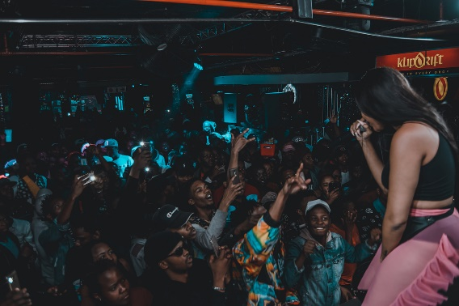
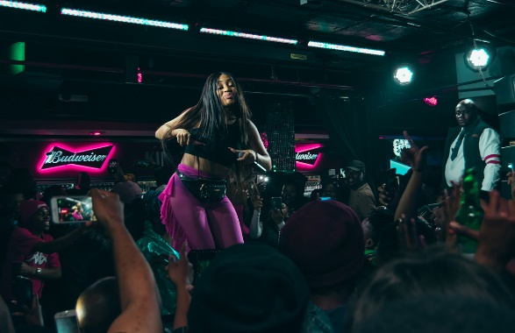
NADIANAKAIVERIFIED ALL SMILES OVER HERRREEEEE 😬 JULY 30, 2018
Analysis Notes: Budweiser brand affiliation visible logo. Dancing, leaning forward and interacting closely with audience. Dressed in black top and pink spandex with tassels. Caption in capital letters: ALL SMILES OVER HERREEEEE. Emoji: Grinning face

Slide 110
ANALYSIS NOTES: Orange long wig and shades on. Dressed in a green and black jumpsuit with a waist bag. Performing on large stage with smoke machines. Caption: Girl on fire, hashtags: #dankiesanconcert #RIPPRO Emojis: flame, thank you or praying hands and camera to credit photographer.
nadianakaiVerified
Girl on fire 🔥 #dankiesanconcert 🙏🏽 #RIPPRO 📷 @lashshots
AUGUST 28, 2018

Slide 111
ANALYSIS NOTES: Making eye contact, leaning forward and smiling with her audience, the deejay is visible in the background. Caption: Channel M always Lit. Exclamation marks and camera emojis.
nadianakaiVerified
Channel M always Lit‼️‼️‼️‼️‼️ 📷 @lashshots
SEPTEMBER 1, 2018

Slide 112
ANALYSIS NOTES: She is jumping and pointing up in the air, her orange wig is in motion. She is wearing an orange sports bra and tracksuit pants. Caption: Shout out to everybody that came out yesterday!!!! I love Day Parties. Exclamation marks and camera emojis.
nadianakaiVerified
Shout out to everybody that came out yesterday!!!! I love Day Parties!‼️‼️‼️‼️ 📷 @lashshots
SEPTEMBER 1, 2018

Slide 113
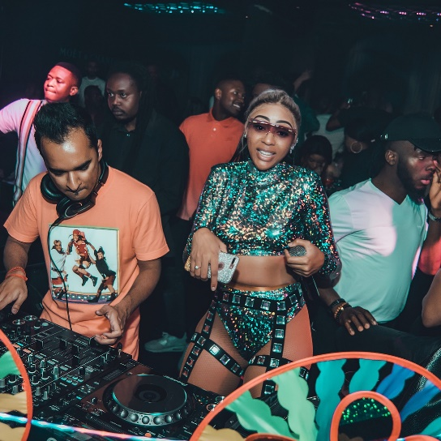
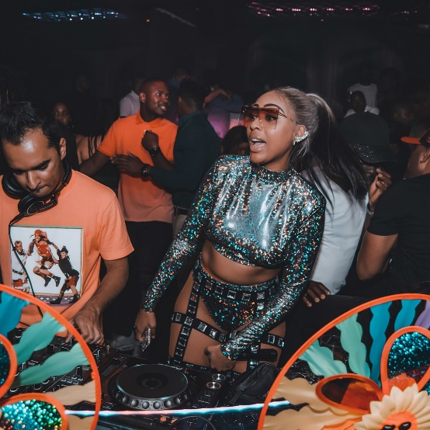
NADIANAKAIVERIFIED LAST NIGHT HAREM WAS SUCH A VARRRRRB!!!! I'M STILL RECOVERING 😂😂😂😂 📷 @LASHSHOTS SEPTEMBER 2, 2018
Analysis Notes: She is dancing and performing next to the deejay. Dressed in a glittering long sleeve crop top and underwear, exposing her waist, hips and thighs. Caption in capital letters: LAST NIGHT HAREM WAS SUCH A VARRRRRB!!!!! I’M STILL RECOVERING. Laughing face and camera emoji.

Slide 114
NADIANAKAIVERIFIED GAUTENG SPORTS AWARDS 2018‼️ 📷 @LASHSHOTS SEPTEMBER 3, 2018
Analysis Notes: She is dancing and performing with other female artists on stage. Caption in capital letters: GAUTENG SPORTS AWARDS 2018. Emojis: exclamation marks and camera.

Slide 115
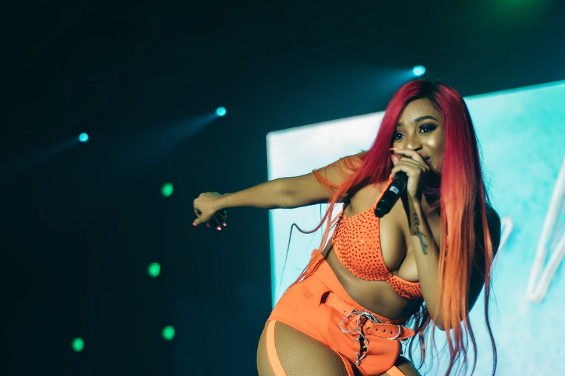
NADIANAKAIVERIFIED NO LIMIT, I'M A SOLDIER! 💪🏽 #HIPHOPHERSTORY 📷 @LASHSHOTS SEPTEMBER 9, 2018
Analysis Notes: The artist is performing, dancing and leaning forward to the audience. Dressed in a orange bikini top and underwear. Wearing a long red and orange wig. Caption in capital letters: NO LIMIT, I’M A SOLDIER! Hashtag: #HIPHOPHERSTORY Emojis: Bicep arm and camera.

Slide 116
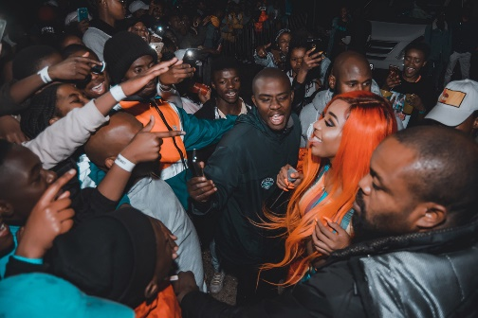
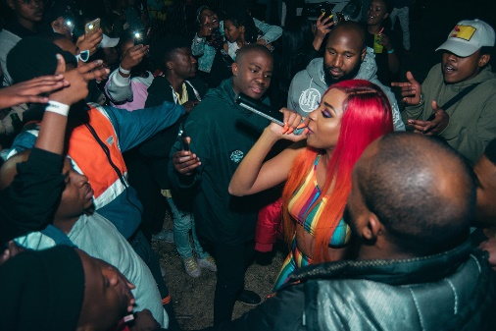
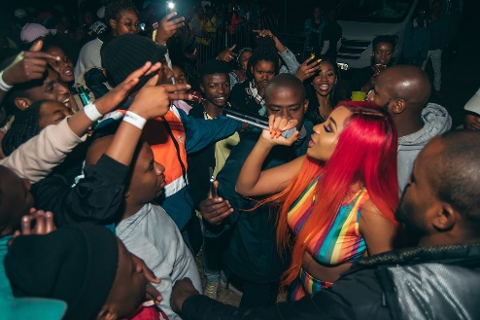
NADIANAKAIVERIFIED 🏳️‍🌈🏳️‍🌈🏳️‍🌈🏳️‍🌈🏳️‍🌈🏳️‍🌈🏳️‍🌈🏳️‍🌈🏳️‍🌈GOOD MORNING‼️‼️‼️ SHOUT OUT MAMELODI‼️🚀🚀🚀🚀 MY OUTFIT FROM @FASHIONNEVER 📷 @LASHSHOTS SEPTEMBER 11, 2018
Analysis Notes: She is surrounded by a large crowd during her performance. Dressed in a rainbow colors sports bra and tights. On her head a red and orange wig. Heavy makeup on her face. Caption in capital letters: GOOD MORNING, SHOUT OUT MAMELODI. MY OUTFIT FROM @FASHIONNEVER Emojis exclamation marks, rockets, rainbow flag and camera.

Slide 117
ANALYSIS NOTES: Shoulder length white wig, heavy makeup with extension eyelashes. Dressed in a sports bra and spandex. Performing in a squat position with her tongue out. Caption: A whole entire mood !!!! Major League Gardens lit a F. Exclamation marks emojis.
nadianakaiVerified
A whole entire mood!!!! Major League Gardens lit as F‼️‼️‼️
SEPTEMBER 15, 2018

Slide 118
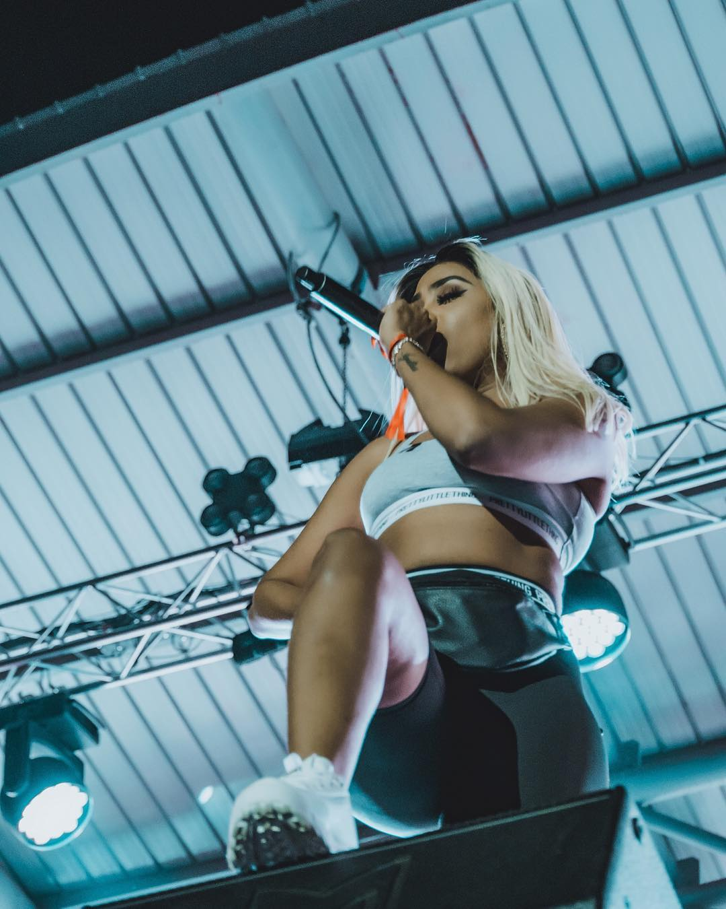
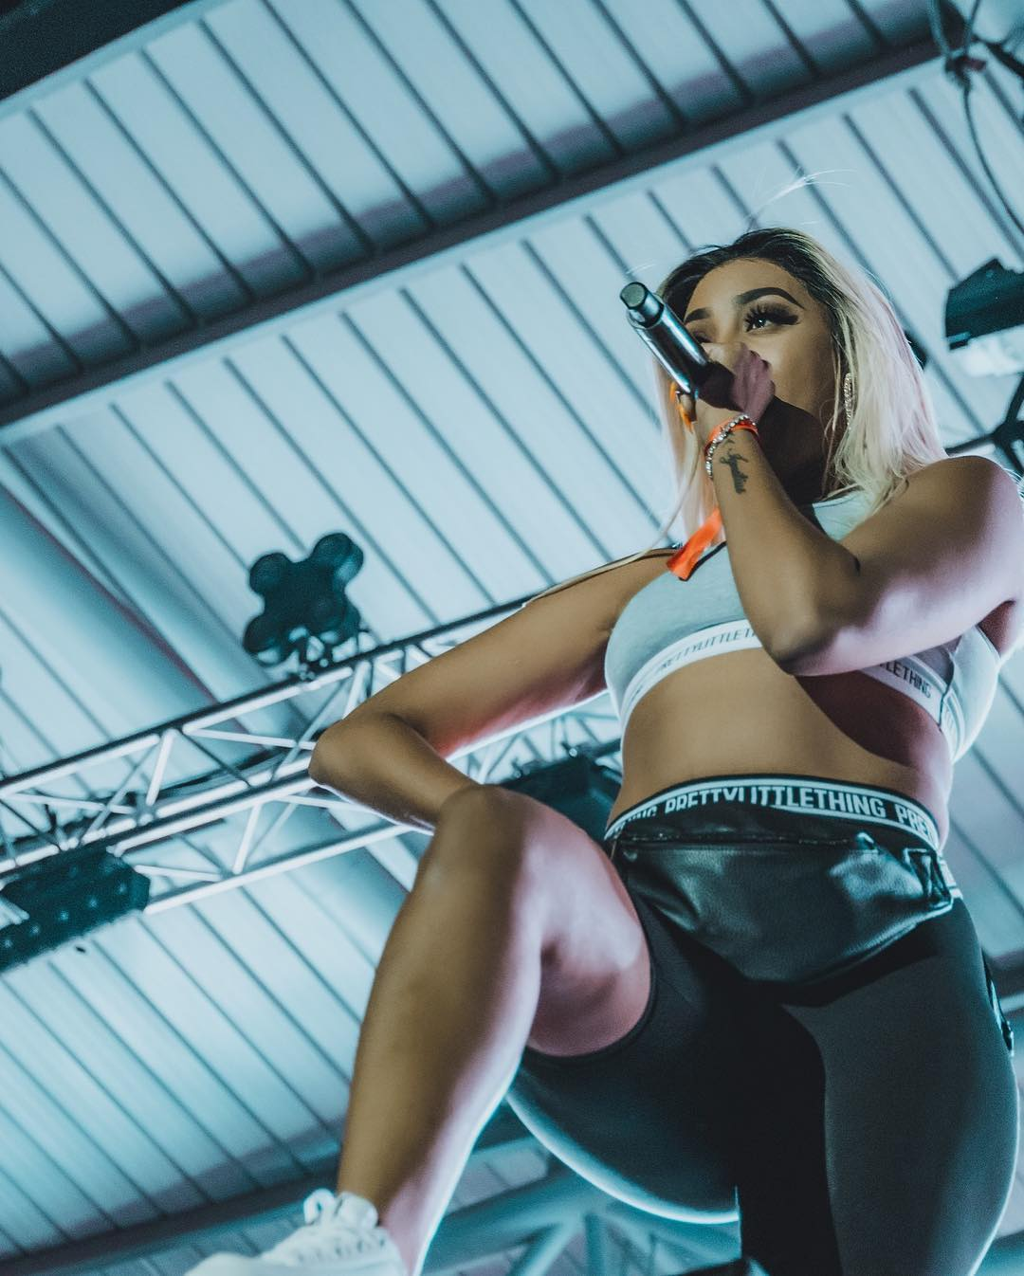
NADIANAKAIVERIFIED #MLG 📷 @LASHSHOTS SEPTEMBER 16, 2018
Analysis Notes: Dressed in sports bra and spandex with waist bag, interacting with the crowd and placing one leg on stage speaker. Hashtag: #MLG and camera emoji.

Slide 119
ANALYSIS NOTES: Blonde bob cut wig, eyelashes, heavy makeup and visible body art on arm. Dressed in a branded Ivy Park sports bra, camouflage pants and a waist bag. Caption: Bout to jump on @wtftumi to perform #lately with my girl @astryd_brown tune in. Exclamation mark emojis.
nadianakaiVerified
Bout to jump on @wtftumi to perform #Lately with my girl @astryd_brown Tune in‼️‼️‼️
SEPTEMBER 17, 2018

Slide 120
ANALYSIS NOTES: Wearing a cap, pink sports bra and underwear with see through tights. Heavy makeup with extension eyelashes on. Caption: Sunny side Block Beach Party is ALWAYS a jump!!!! Hashtag: YassBitch. Tongue out and camera emojis.
nadianakaiVerified
Sunny side Block Beach Party is ALWAYS a jump!!!! 😜 #YassBitch! 📷 @lashshots
SEPTEMBER 25, 2018

Slide 121
ANALYSIS NOTES: Performing in a squat position. Dressed in all black casual outfit. Caption: F*ck it up! No emoji.
nadianakaiVerified
F*ck it up!
SEPTEMBER 29, 2018

Slide 122
ANALYSIS NOTES: Dancing and performing with the deejay visible in the background. Dressed in a long sleeved bodysuit, a coat and knee length chrome boots. Red and orange long wig, long nails and heavy makeup on. Caption: Mood all week lol!!!! hashtag: #Yass! Tongue out emoji.
nadianakaiVerified
Mood all week lol!!!! 😜 #Yass!
OCTOBER 1, 2018

Slide 123
ANALYSIS NOTES: She is dancing on stage. Caption: Yass Bitch!!!!!!! No emoji.
nadianakaiVerified
Yass Bitch!!!!!!
OCTOBER 1, 2018

Slide 124
ANALYSIS NOTES: Extension eyelashes and heavy makeup on. Long blonde weave, choker, waist bag and ring as accessories. Dressed in a jumpsuit. Performing with one hand between her thighs. Caption: Bloem!!!!! I love you soooo much!!!! THANK YOU, hashtags: event name #Macufe, TshepeVsNewWave Emojis: Red heart, flame, rocket, and camera.
nadianakaiVerified
Bloem!!!!! I love you soooo much!!!! THANK YOU ❤️🔥🚀 #Macufe #TshepeVsNewWave 📷 @lashshots
OCTOBER 6, 2018

Slide 125
ANALYSIS NOTES: She is performing on a big stage. Caption in capital letters: ROCKSTAR. Snake and camera emoji.
nadianakaiVerified
ROCKSTAR 🐉🐉🐉 📷 @lashshots
OCTOBER 6, 2018

Slide 126
NADIANAKAIVERIFIED 🚀🚀🚀 📷 @LASHSHOTS OCTOBER 15, 2018
Analysis Notes: Long blonde wig, shades, long nails, makeup and waist bag. Squat position and posing. Performing with other male artists on stage. Dressed in orange jumpsuit and sneakers. No caption. Rockets and camera emojis.

Slide 127
NADIANAKAIVERIFIED ❤️❤️🚀🚀 📷 @LASHSHOTS OCTOBER 28, 2018
Analysis Notes: Green bob cut wig. Wearing a peach crop tank top with tights. Heavy makeup and extension eyelashes. Interacting with audience in close proximity. No caption. Red hearts, rockets and camera emojis.

Slide 128
ANALYSIS NOTES: Performing as she walks into a guess pool party. Red and orange long wig. Wearing a tight blue short dress and heels. Caption: Heeey now!! super fun performing at the @guess pool party hashtag: #loveguess. Emojis: Tongue out face and camera.
nadianakaiVerified
Heeey now!! 😝 super fun performing at the @guess pool party #loveguess 📷 @lashshots
NOVEMBER 15, 2018

Slide 129
ANALYSIS NOTES: Performing on a strip pole dressed in a bodysuit. Shades and long white wig on. Caption: Lol! @moonchildsanelly is a really bad influence!!!! Had fun tho!!!! Emojis: Laughing and red devil face.
nadianakaiVerified
Lol! @moonchildsanelly is a really bad influence!!!! Had fun tho!!!!! 🤣😈
NOVEMBER 24, 2018

Slide 130
ANALYSIS NOTES: Dressed in boots, see through tight and sports jacket with sweater tied around waist. Performing on stage with large speakers in the background. Caption: So grateful for all the opportunities I’ve been given this year!!! Sunday’s are perfect for reflection and giving thanks to the most high! Hope you all having a great Sunday. Praying or thank you hands, Stars and camera emojis.
nadianakaiVerified
So grateful for all the opportunities I’ve been given this year!!! Sunday’s are perfect for reflection and giving thanks to the most high! 🙏🏾 hope you all having a great Sunday 💫 📸 @lashshots
NOVEMBER 25, 2018

Slide 131
ANALYSIS NOTES: Stink face with one leg on stage speakers. Deejay and videographer are visible in the background. Dressed in fishnet stockings, a white bomber jacket and underwear. Caption: Capsule Fest Mooooooood. No emoji.
nadianakaiVerified
Capsule Fest MOOOOoOd
NOVEMBER 26, 2018

Slide 132
ANALYSIS NOTES: Dressed in a bodysuit and fishnet stockings. Hands in the air, the artist is dancing and performing with backup dancers. Caption: The point of rehearsals!!!! I’ll always catch the moves! NO MATTER which show it is! Thanks to the dancers that always come thru!!!! Hashtag: #Fillupmosesmabhida. Camera emoji.
nadianakaiVerified
The point of rehearsals!!!! I’ll always catch the moves! NO MATTER which show it is! Thanks to the dancers that always come thru!!!! #fillupmosesmabhida 📷 @lashshots
DECEMBER 2, 2018

Slide 133
ANALYSIS NOTES: Long, eyelashes, nails and wig and balaclava face mask on. Dressed in a bodysuit with tassels. She is performing with another male artist and dancing on stage with one hand pointing between her thighs. Caption: SIT on your mans face, THATS what I call a facial…. Hashtag: #fillupmosesmabhida. Camera emoji.
nadianakaiVerified
SIT on your mans face, THATS what I call a facial.... #fillupmosesmabhida 📷 @lashshots
DECEMBER 2, 2018

Slide 134
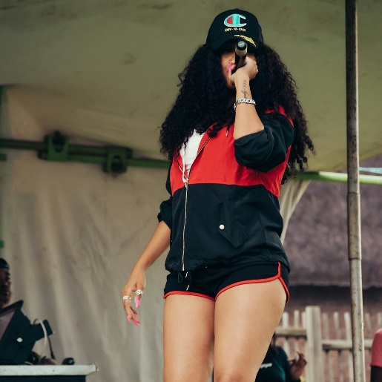
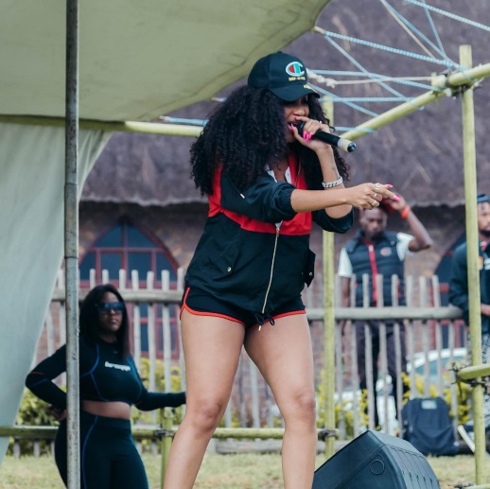
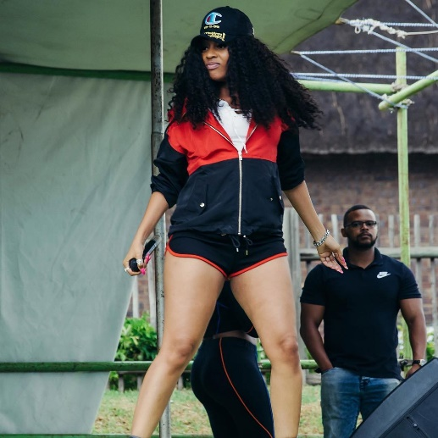
NADIANAKAIVERIFIED MOOD ALL DECEMBER 😝 📷 @LASHSHOTS DECEMBER 4, 2018
Analysis Notes: Performing in a tent, dancing in a squat position. Dressed in a sporty outfit, shorts, jacket and cap inside a curly long wig. Caption in capital letters: MOOD ALL DECEMBER. Emojis laughing face and camera.

Slide 135
ANALYSIS NOTES: Posing on stage with a microphone in hand. Long wig and eyelashes. Dressed in a balaclava and bodysuit with glittering details and fishnet stockings. Caption in capital letters: VENOM. Camera emoji to credit photographer.
nadianakaiVerified
VENOM 📷 @nkanyisonqhome
DECEMBER 4, 2018

Slide 136
ANALYSIS NOTES: Dancing to her audience. Caption: Smooooood this weekend!!!!! Tongue out emoji.
nadianakaiVerified
Smoooood this weekend!!!!!! 😋
DECEMBER 7, 2018

Slide 137
ANALYSIS NOTES: Standing in a pose during her stage performance. Long weave, t-shirt, bum shorts and sneakers or reefs. Hashtag: #maftownheights. Red hearts and camera emoji.
nadianakaiVerified
#maftownheights ❤️❤️ 📷 @lashshots
DECEMBER 8, 2018

Slide 138
ANALYSIS NOTES: Colourful curly wig on, long eyelashes and heavy makeup. Performing with other male artists on stage. Ciroc brand affiliation. Caption: ICONic. no emoji.
nadianakaiVerified
ICONic
DECEMBER 11, 2018

Slide 139
NADIANAKAIVERIFIED BEASTMODE!!!! SHOUT OUT FREE STATE! YOU GUYS WERE SOOOO LIT! ENERGY ON 💯 🚀🚀🚀 DECEMBER 16, 2018
Analysis Notes: Dressed in a black tank top and camouflage pants and ankle boots. Blonde long wig. In squat position, she is leaning forward to her audience. Caption in capital letters: BEASTMODE!!!! SHOUT OUT FREE STATE! YOU GUYS WERE SOOOO LIT! ENERGY ON 100 and rocket emoji.

Slide 140
ANALYSIS NOTES: Artist intimately interacting with audience. Long colourful wig on. Caption: Fresh prince of Maftown. Green heart emoji
nadianakaiVerified
Fresh prince of Maftown💚
DECEMBER 23, 2018

Slide 141
ANALYSIS NOTES: Point her fingers out. Long green wig, heavy makeup and extension eyelashes. Black crop tank top and bum shorts. exposing her arms, waist and thighs. Hashtag: #freshprinceofmaftown no emoji.
nadianakaiVerified
#freshprinceofmaftown
DECEMBER 23, 2018

Slide 142
ANALYSIS NOTES: Looking and interacting with the audience. Long white and green curly wig. Torn bum shorts and black sneakers. Hashtag: #freshprinceofmaftown no emoji.
nadianakaiVerified
#freshprinceofmaftown
DECEMBER 23, 2018

Slide 143
ANALYSIS NOTES: She is looking at the deejay on stage. Ciroc brand affiliation. Caption: Lit! Hashtag: #Freshprinceofmaftown Emojis: Shades on face and camera.
nadianakaiVerified
Lit! 😎 #Freshprinceofmaftown 📷 @lashshots
DECEMBER 23, 2018

Slide 144
ANALYSIS NOTES: She is performing with a female deejay on stage. Big smiles on their faces. Wearing thigh high boots, a bodysuit and fishnet stockings. Caption: Having the best Christmas with my girl @ayandamvp who’s killing it at @shimza.dj One Man Show Right NOW!!!! Christmas tree emoji.
nadianakaiVerified
Having the best Christmas with my girl @ayandamvp who’s killing it at @shimza.dj One Man Show Right NOW!!!! 🎄
DECEMBER 26, 2018

Slide 145
ANALYSIS NOTES: She is gazing at the audience during her stage performance. Her hips, thighs and buttocks are exposed. Hashtag: #OMS2018 Camera emoji to credit photographer.
nadianakaiVerified
#OMS2018 📷 @lashshots
DECEMBER 26, 2018

Slide 146
ANALYSIS NOTES: Performing on stage. She is making a gun point hand gesture. Black and white curly wig, short outfit with sneakers exposing her legs. Caption: We Back Home was LIT last night!!!!!! Shout out to everyone’s that came thru! We partied till 5am!!!! Sunrise ish in Thaba Nchu!!!!!!! Let’s do it again next year! Kisses emoji.
nadianakaiVerified
We Back Home was LIT last night!!!!!! Shout out to everyone that came thru! We partied till 5am!!!! Sunrise ish in Thaba Nchu!!!!!! Let’s do it again next year! 😘
DECEMBER 27, 2018

Slide 147
ANALYSIS NOTES: Pointing the microphone out to the audience. Wearing black knee high boots, stockings with a pattern and long sleeve lace bodysuit with a long curly colourful wig. Caption: Just Rocket Rands Cape Town! Tongue out emoji.
nadianakaiVerified
Just Rocked Rands Cape Town! 😜
DECEMBER 30, 2018

Slide 148
ANALYSIS NOTES: Audience is trying to reach out for her. She is performing in squat position. Caption: Rands!!!! No emoji.
nadianakaiVerified
Rands!!!!!
DECEMBER 30, 2018

Slide 149
ANALYSIS NOTES: Performing in close interaction with the audience. Red devil emoji.
nadianakaiVerified
😈
DECEMBER 31, 2018

Slide 150
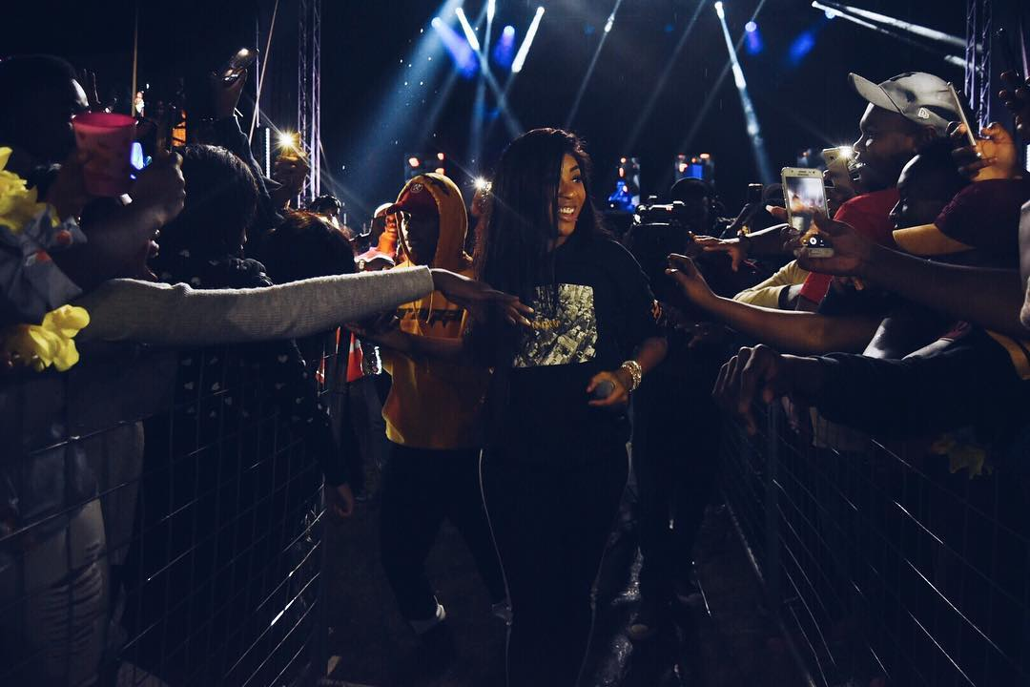
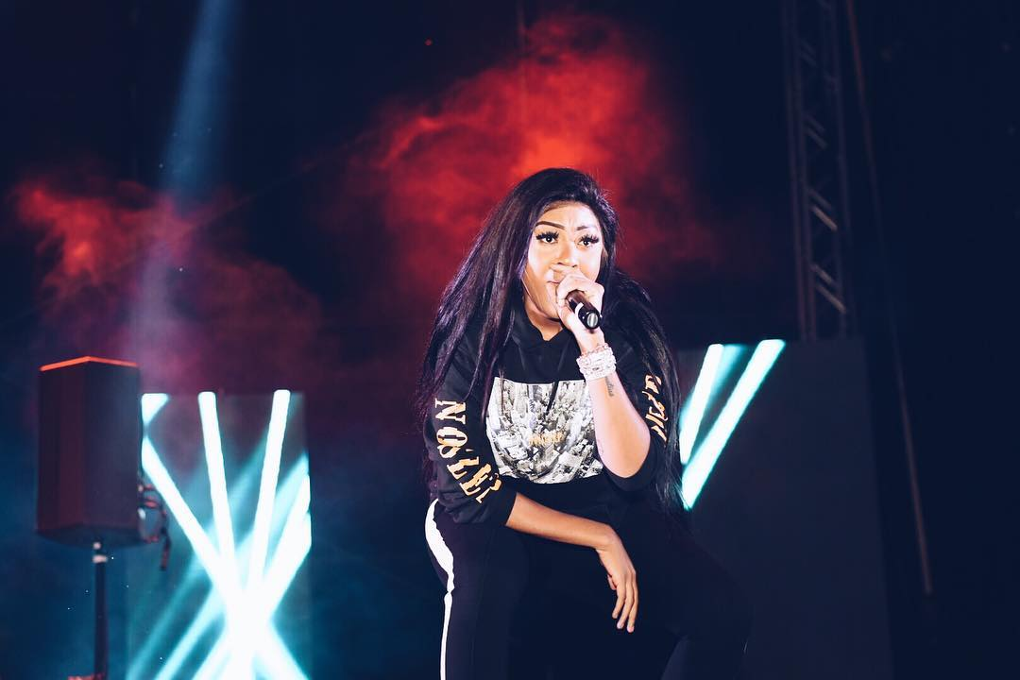
NADIANAKAIVERIFIED SASOLBURG IS ALWAYS A JUMP!!!! GIG 1 OF 5 DONE AND DUSTED! 📷 @LASHSHOTS DECEMBER 31, 2018
Analysis Notes: The audience is reaching out to touch her as she walks through the crowd to perform on stage. Wearing a black comfortable tracksuit. Caption in capital letters: SASOLBURG IS ALWAYS A JUMP!!!! GIG 1 OF 5 DONE AND DUSTED! Camera emoji to credit photographer.

Slide 151
ANALYSIS NOTES: She is performing and dancing on stage. Caption: 2019! Emojis: Party poppers and champagne
nadianakaiVerified
2019! 🎉🎊🍾
JANUARY 1, 2019

Slide 152
ANALYSIS NOTES: She is gazing at the audience. Caption: 2019!!!! What it look like!!!!!? Camera emoji.
nadianakaiVerified
2019!!!! What it look like!!!!!? 📷 @lashshots
JANUARY 1, 2019

Slide 153
ANALYSIS NOTES: Short updo wig with fringe. Earring and necklace, makeup and extension eyelashes. Performing in close proximity to audience with a big smile. red hearts and camera emojis.
nadianakaiVerified
❤️❤️❤️ 📷 @lashshotsstudios
FEBRUARY 16, 2019

Slide 154
NADIANAKAIVERIFIED TABOO A JUMP!!!!!! 📷 @LASHSHOTSSTUDIOS MARCH 23, 2019
Analysis Notes: The artist is performing and dancing for the audience inside a club. Wearing a long blonde wig with a fringe, necklace, bikini top and tracksuit pants. Caption in capital letters: TABOO A JUMP!!!!! Camera emoji

Slide 155
ANALYSIS NOTES: The artist is leaning forward in a pose. Big long curly colourful wig. She is dressed in a black g-string bodysuit and knee high stiletto heel boots. Caption in capital letters: YES BUMS!!! Camera, winking and tongue out emojis.
nadianakaiVerified
YES BUMS!!! 😜😜😜 📷 @lashshotsstudios
APRIL 20, 2019

Slide 156
NADIANAKAIVERIFIED IVE BE3N IT, A BEAST WIT IT!!!! #BTTC WAS PHUCKING FIRE!!!!! 🔥 APRIL 27, 2019
Analysis Notes: She is performing on stage in a squat position, on the next frame she is pointing her finger to the side with a serious face. Wearing black thigh high boots, bomber jacket, sports bra and colourful underwear. Caption in capital letters: IVE BE3N IT, A BEAST WIT IT!!!! #BTTC WAS PHUCKING FIRE!!!!! Fire emoji.

Slide 157
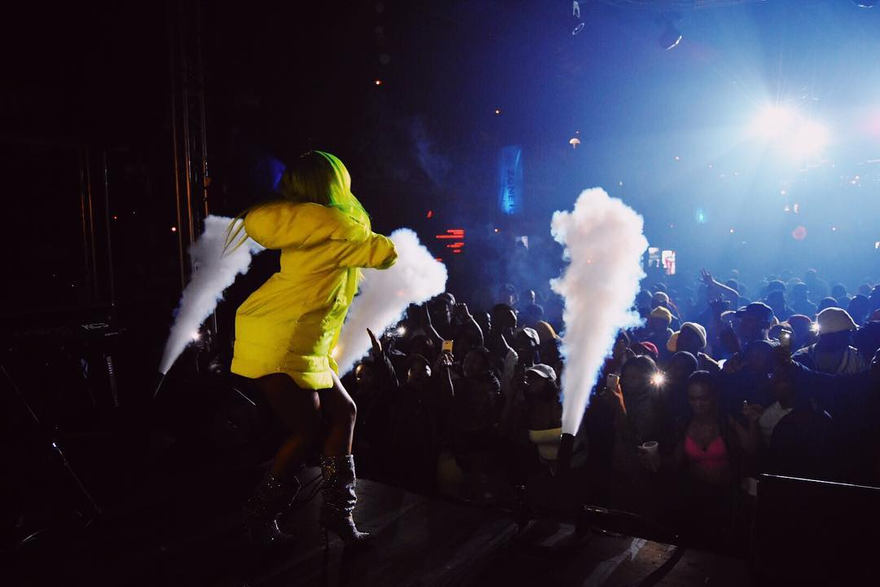
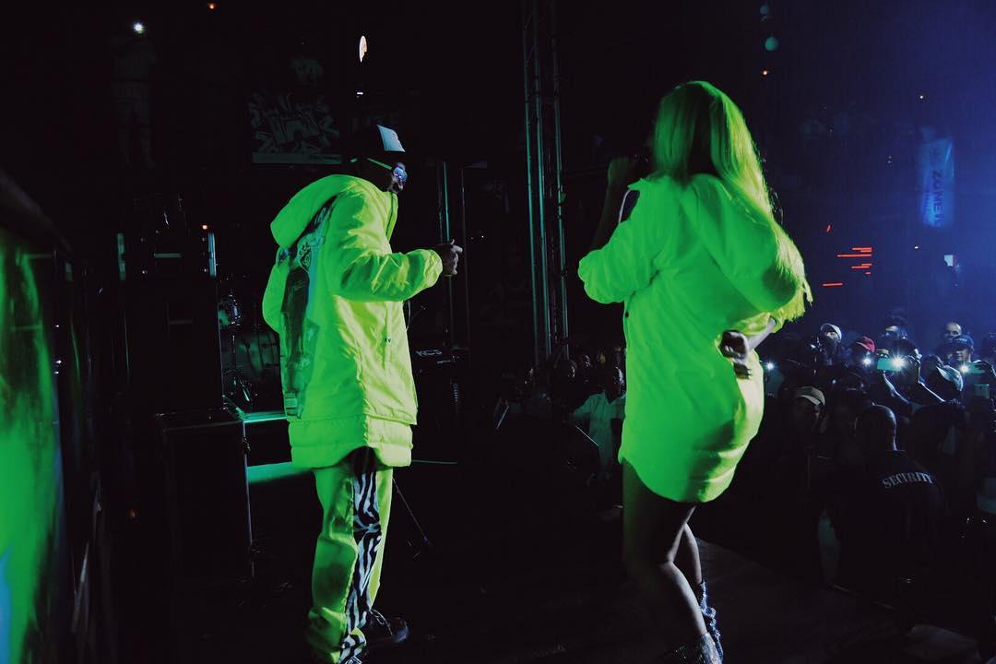
NADIANAKAIVERIFIED COMBOS COMMUNICATING!!!!! 📷 @LASHSHOTSSTUDIOS #SPEEDSTAANNUALBIRTHDAYCONCERT #NADIANAKED #28.06.19 MAY 4, 2019
Analysis Notes: The is performing on stage with another male artist. Green and yellow wig, glittering ankle boots. Squat position. Wearing a yellow jacket with hoodie. Capital letters caption: COMBOS COMMUNICATING!!!!! Hashtags: #SPEESTAANNUALBIRTHDAYCONCERT #NADIANAKED #280619

Slide 158
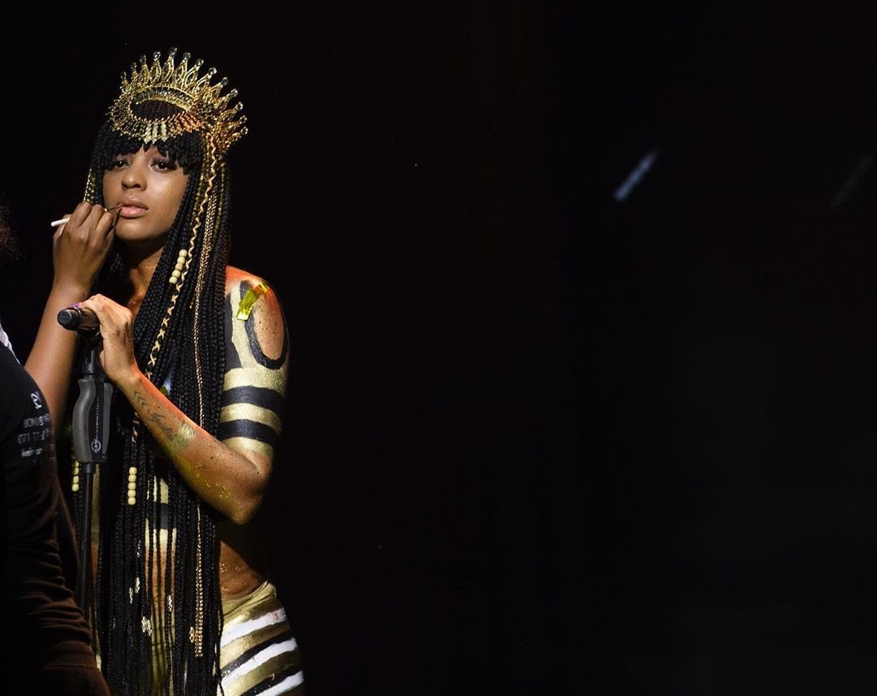
NADIANAKAIVERIFIED I GOT TO RECREATE MY ALBUM COVER FOR MY YO MTV RAPS PERFORMANCE! MAKE SURE YOU CHECK IT OUT TOMO 6PM CHANNEL 322!!! IT’S ALSO THE FIRST TIME I PERFORMED IMMA BOSS!!! 16 DAYS TO GO TILL NADIA NAKED! ( SIDE NOTE-THIS BODY PAINT TOOK TWO HOURS TO DO! ALSO FOR MY ALBUM COVER 😰🤗) JUNE 12, 2019
Analysis Notes: He body is covered in body paint and she is wearing a crown on her African braids. Caption in capital letters: I GOT TO RECREATE MY ALBUM COVER FOR MY YO MTV RAPS PERFORMANCE! MAKE SURE YOU CHECK IT OUT TOMO 6PM CHANNEL 322!!! IT’S ALSO THE FIRST TIME I PERFORMED IMMA BOSS!!! 16 DAYS TO GO TILL NADIA NAKED! ( SIDE NOTE-THIS BODY PAINT TOOK TWO HOURS TO DO! ALSO FOR MY ALBUM COVER. Hugs and sweating emojis.

Slide 159
ANALYSIS NOTES: She is covered in body art, sitting on a chair and gazing at the camera. On her caption she asks her whether her followers have pre-ordered her album yet? No hashtag and no emoji.
nadianakaiVerified
15 days till Nadia Naked! Have you pre ordered the album yet?!
JUNE 13, 2019

Slide 160
ANALYSIS NOTES: She is performing with both hands on her waist. Caption: 20 mins to go! Yo MTV raps! Channel 322! 6pm! #NadiaNaked #280619 There is no emoji.
nadianakaiVerified
20 mins to go! Yo MTV raps! Channel 322! 6pm! #NadiaNaked #28.06.19
JUNE 13, 2019

Slide 161
ANALYSIS NOTES: Caption she thanks all involved in recreating her album cover. @samlotterdell @takezito @whereareyoutalent @hoodhighfashion @theonlyscoopmakhathini No emoji.
nadianakaiVerified
And that’s a wrap!!! Thank you Yo MTV Raps for bringing my album cover to life! Was such a blessing working with everyone on this show!!!! Thank you @samlotterdell @takezito @whereareyoutalent @hoodhighfashion @theonlyscoopmakhathini
JUNE 13, 2019

Slide 162
ANALYSIS NOTES: On her head is a black curly wig, face covered in ski goggles and a balaclava mask. She is wearing thigh high straps boots, a long sleeve bodysuit and a yellow jacket. Long nails on her hands and she is wearing fishnet stockings on her legs.
nadianakaiVerified
Don’t get GASSED 📷 @lashshotsstudios ( I’m wearing Nadia Nakai x Redbat bodysuit and Bomber jacket from my next drop, dropping in July! )
JUNE 17, 2019

Slide 163
ANALYSIS NOTES: Announcing her album launch. Wearing a long khaki dress with a slit, thigh high straps black boots. Her wig and nails are long. Emojis: Camera, Thank you or praying hands, red and pink hearts.
nadianakaiVerified
Thank you sooooo much to EVERY single person that took the time to come out to my Album launch last night!!!! I’m so happy you all are enjoying the Album!!! It means the world to me... I swear I’ve got no words! Thank you @cinnelstore for making my beautiful dress for my performance for Africa! Please get my new album Nadia Naked on all Digital platforms link in my bio! And in Musica Stores! 🙏🏾💕💕 📷 @lashshotsstudios
JUNE 28, 2019

Slide 164
NADIANAKAIVERIFIED @AYANDAMVP I LOVE YOU SOOOOO MUCH!!!!! THANK YOU FOR HOSTING MY #NADIANAKEDXPERIENCE AND ALWAYS BEING THERE WHEN I NEED YOU! I LOVE YOU! MY DRESS ALSO BY @CINNELSTORE #NADIANAKEDOUTNOW JUNE 28, 2019
Analysis Notes: The artist is being interviewed about her new album. Dressed in a shimmering chrome short dress. Choker, earings, long wig, heavy makeup on. Thanking the @CINNELSTORE for the dress and the host @AYANDAMVP. Hashtag: NADIANAKEDOUTNOW There is no emoji.

Slide 165
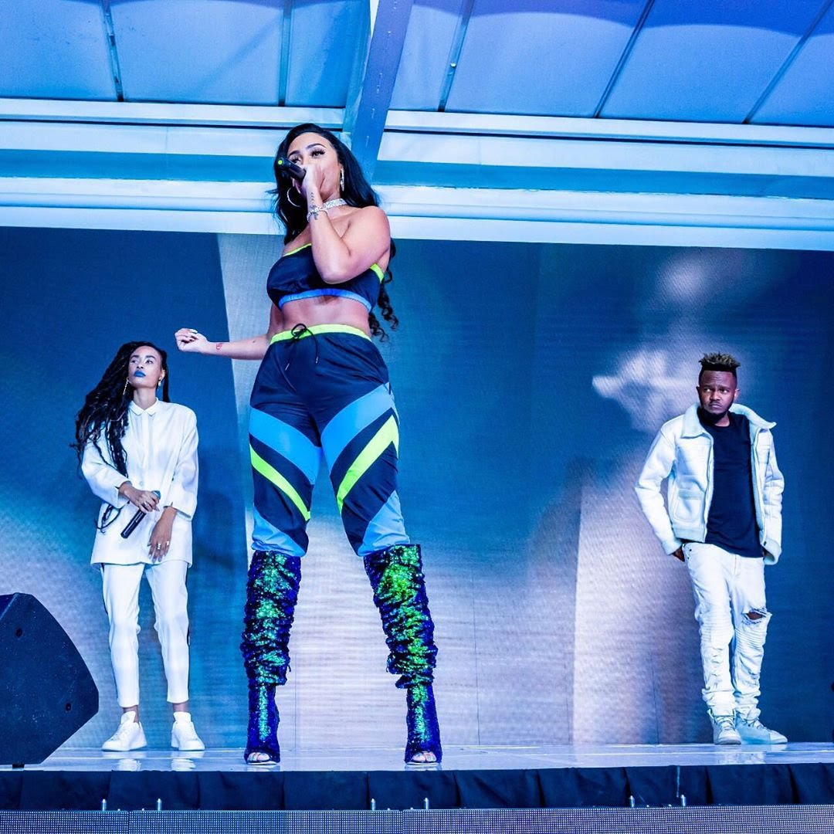
NADIANAKAIVERIFIED @KWESTADAKAR AND @IAM_SIO THANK YOU! THANK YOU!!! HAVE YOU GUYS HEARD KREATURES YET!? @GASPHOTOGRAPHIC JUNE 28, 2019
Analysis Notes: The artist is performing on stage with both a male and female artist. Dressed in a boobtude and trackpants with shimmering knee high stiletto heel boots. Caption: she is thanking both artists performing with her and mentioning the photographer.

Slide 166
NADIANAKAIVERIFIED CHANKURA 🔥🙆🏽‍♀️ JUNE 30, 2019
Analysis Notes: The artist is performing on stage at the channel O event with another male artist. Dressed in a casual tracksuit pants and crop tank top with a long wig on her head and shades on her face. Caption in capital letters: CHANKURA. Emojis: flames and hands on head.

Slide 167
ANALYSIS NOTES: Performing at her album media launch. Hashtag: #NADIANAKED Caption: out now!!!! Link in my bio! No emoji.
nadianakaiVerified
#NADIANAKED out now!!!! Link in my bio!
JUNE 30, 2019

Slide 168
ANALYSIS NOTES: The artist is performing in a club. Hairstyle in green African braids. Caption: Taboo! No emoji.
nadianakaiVerified
Taboo!
JULY 21, 2019

Slide 169
ANALYSIS NOTES: She is performing with a big smile on her face. Green African braids hairstyle, extension eyelashes and heavy makeup. Caption: Nadia Naked out now! Camera emoji.
nadianakaiVerified
Nadia Naked out now! 📷 @donkat_seles
JULY 21, 2019

Slide 170
ANALYSIS NOTES: She is wearing a animal print jumpsuit. Long wig, nails and eyelashes. Caption: You say you the truth, well you gonna have to prove it. Camera emoji.
nadianakaiVerified
You say you the truth, well you gonna have to prove it! 📸 @donkat_seles
JULY 27, 2019

Slide 171
NADIANAKAIVERIFIED MOOD WHEN MY ALBUM WAS PLAYING @MOJA_CAFE_ LAST NIGHT! 📸 @DONKAT_SELES JULY 29, 2019
Analysis Notes: Shoulder length curly wig, long sleeve bodysuit and thigh high straps boots. Caption in capital letters: MOOD WHEN MY ALBUM WAS PLAYING @MOJA_CAFE LAST NIGHT! Camera emoji.

Slide 172
NADIANAKAIVERIFIED TODAY WAS SOOO AMAZING!!! #NADIANAKEDSCHOOLTOUR! THANK YOU CEDAR HIGH AND MR MILLER FOR HAVING ME!!! 📸 @LASHSHOTSSTUDIOS AUGUST 2, 2019
Analysis Notes: She is performing at a high school. Caption thanking Mr Miller for having her. Hashtag: #NADIANAKEDSCHOOLTOUR Camera emoji to credit photographer. Long wig and jumpsuit on.

Slide 173
ANALYSIS NOTES: Red and orange wig on. Black shoes, stockings, bodysuit and jacket, silver mini skirt, heavy makeup and extension eyelashes. Caption: mentions her morning show sa performance on ETV. There is no emoji.
nadianakaiVerified
Goooood Morning! I hope you caught my live performance of More Drugs from my Album on ETV #MorningShowSa
AUGUST 9, 2019

Slide 174
ANALYSIS NOTES: Brand affiliation, dressed in a Reebok tracksuit set. Hashtags: #enoughisenough, #noxenophobia and mentions @reeboksouthafrica @sportscene_sa, Camera emoji to credit photographer.
nadianakaiVerified
@reeboksouthafrica @sportscene_sa 📷 @lashshotsstudios #noxenophobia #enoughisenough
SEPTEMBER 6, 2019

Slide 175
ANALYSIS NOTES: The artist is wearing a long orange and yellow wig, latex tight black pants and a bomber orange jacket, Caption mentions her performance at NWU RAG FEST! Emoji: flames and camera.
nadianakaiVerified
NWU RAG FEST! 🔥🔥🔥 📷 @lashshotsstudios
SEPTEMBER 8, 2019

Slide 176
ANALYSIS NOTES: The artist is performing to an audience with a smile on her face. Dressed in a bikini top and black see through mesh fabric long pants. Long orange wig on her head. Caption: THEN I got wet! Emojis: laughing face, water droplets and camera.
nadianakaiVerified
THEN I got wet! 🤣💦💦💦💦 📷 @lashshotsstudios
SEPTEMBER 14, 2019

Slide 177
ANALYSIS NOTES: The artist is leaning forward while stretching out the microphone to her audience. Caption: What a vibe!!!! Hashtag: #DubaneSpringBreak No emoji
nadianakaiVerified
What a vibe!!!! #DubaneSpringBreak
SEPTEMBER 14, 2019

Slide 178
ANALYSIS NOTES: The artist is dancing in close proximity with a fans. Caption Spicy! Red chilli emojis.
nadianakaiVerified
🌶🌶🌶Spicy! 🌶🌶🌶🌶
SEPTEMBER 28, 2019

Slide 179
NADIANAKAIVERIFIED WHICH SONG WERE WE PERFORMING?! NAAA MEEAN, TOP SHAYELA, RAGGA OR CHANKURA?! 📷 @SPLASHY_95 OCTOBER 22, 2019
Analysis Notes: The artist is performing on stage with another male artist. She is wearing a pink latex pants and a crop leather jacket. Has on makeup, nails and wig. Mentions: @SPLASHY_95 Emoji: Camera

Slide 180
Analysis notes: Artist is performing with a deep gaze on her face, seated with a long wig, heavy makeup and extension eyelashes. Wearing animal print black and orange dress. Visible body art on arm and hands. Earrings, chain, rings and bracelet jewelry. Emoji: Musical note.
NadianakaiVerified
🎶
NOVEMBER 9, 2019

Slide 181
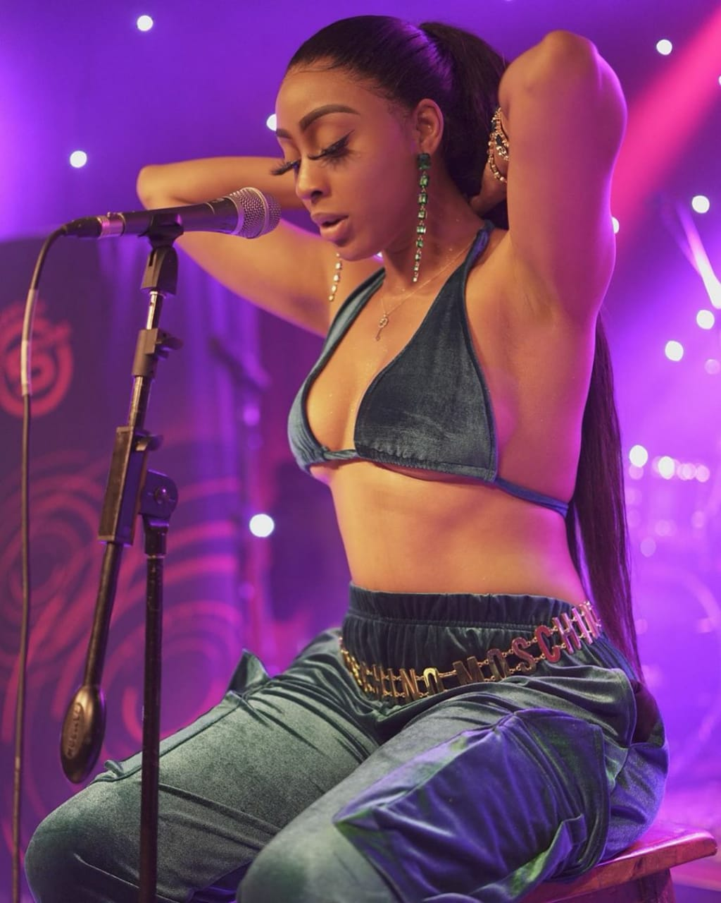
Analysis notes: She is performing for 5FM, seated. wearing a velvet bikini top and tracksuit pants. Long wig in a ponytail, earrings, chain, belt, bracelet, extension eyelashes and heavy makeup. Mentions: @5fm @mscosmosa
NadianakaiVerified
Thank you for tuning into @5fm for my performance! Shout out @mscosmosa and @5fm
NOVEMBER 10, 2019

Slide 182
Performing with a smile on her face, deejay visible in the background. Caption: Thank you for tuning into, for my performance! Shout out Mentions: @mscosmosa and @5fm
nadianakaiVerified
Thank you for tuning into @5fm for my performance! Shout out @mscosmosa and @5fm
NOVEMBER 10, 2019

Slide 183
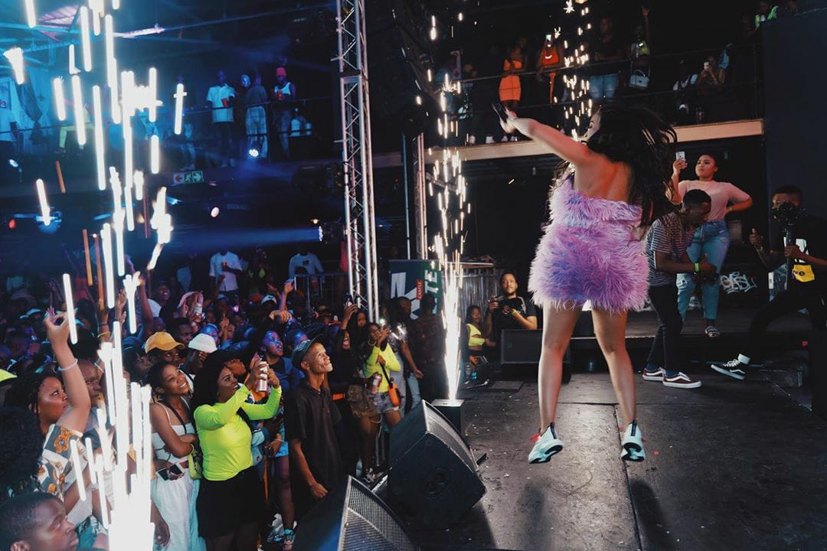
nadianakaiVerified Back like I never left.... 🔥🤘🏾 NOVEMBER 30, 2019
The artist is performing on stage to a large audience. There is interaction with the crowd. She is dressed in a fur boobtube dress and sneakers. Long wig, makeup and nails on. Caption: Back like I never left…. Emojis: Flame and pinky and index finger gesture.

Slide 184
The artist is performing on a large stage with the deejay in the background. Wearing a short tight long sleeve dress and ankle boots. Has on long eyelashes and blonde wig. Words on caption: Always been on some Boss shit! keep streaming my album Nadia Naked, get familiar before the show! Mentions: @lashshotsstudios Emojis: camera and flame.
nadianakaiVerified
Always been on some Boss shit! 📷 @lashshotsstudios keep streaming my album Nadia Naked, get familiar before the show! 🔥
DECEMBER 2, 2019

Slide 185
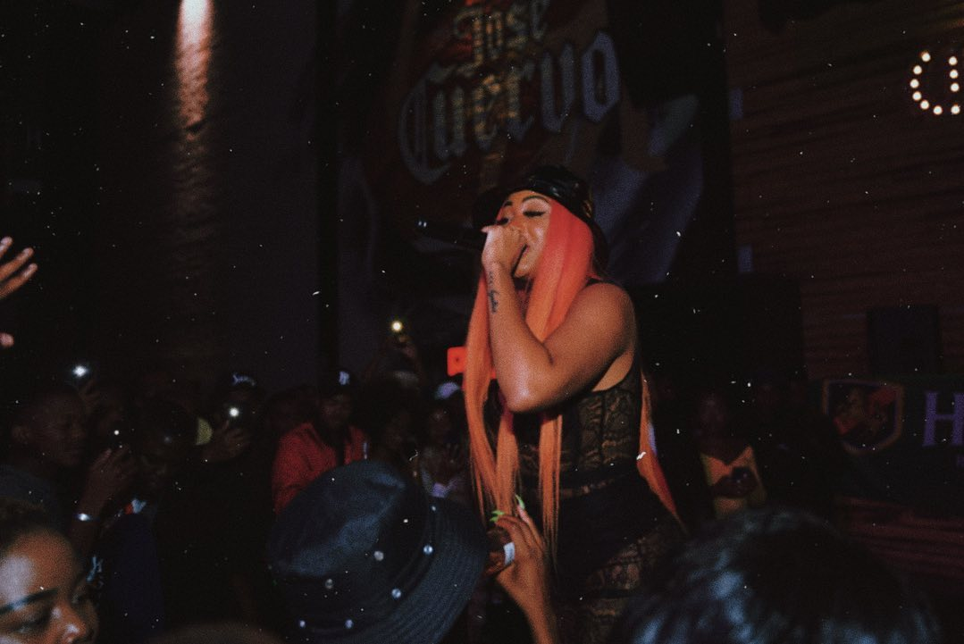
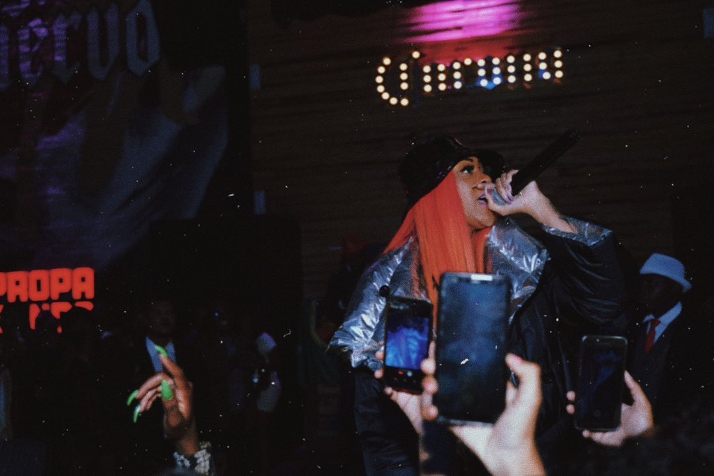
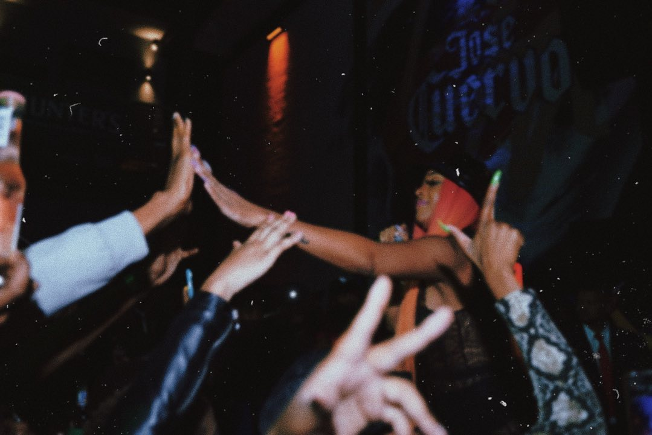
nadianakaiVerified Fuck I really love this shit!!! DECEMBER 7, 2019
The artist is performing inside a club, hairstyle in orange wig. Interacting with the crowd. Caption: Fuck I really love this shit!!! No emoji.

Slide 186
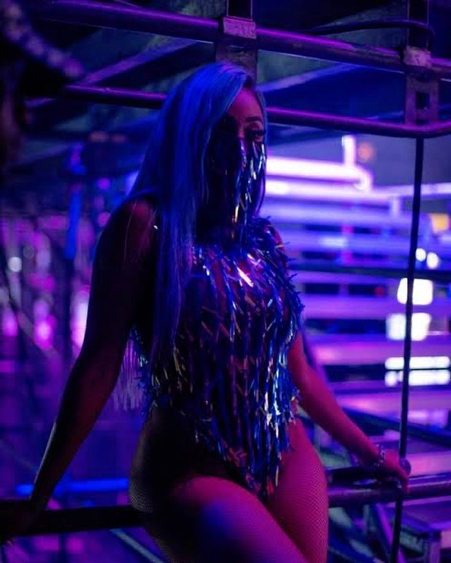
Dressed in a long wig, baklava, fishnet stockings and bodysuit with tassel detail. The artist is posing backstage. Words on caption: this week!!!!!! You know this one is gonna be the best one yet!!! God is clearing the sky’s for an epic show!!!! Hashtag: #filluproyalbafokeng Emoji: flame and happy devil.
nadianakaiVerified
#filluproyalbafokeng this week!!!!!! You know this one is gonna be the best one yet!!! 🔥🔥🔥🔥. God is clearing the sky’s for an epic show!!!! 😈
DECEMBER 11, 2019

Slide 187
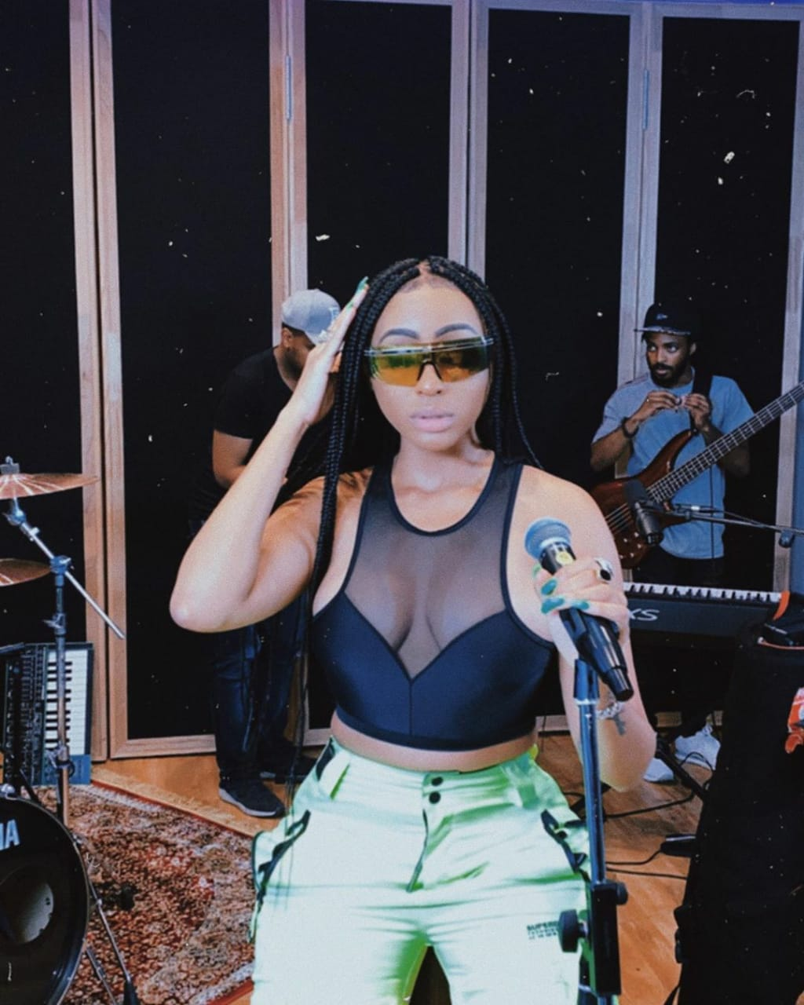
The artist is performing seated on a bar stool with a live band in the background. Dressed in a crop top and cargo pants. African box braid hairstyle, heavy makeup, ring and shades on. Words on caption in capital letters: NEW TYPE.
nadianakaiVerified
NEW TYPE.

Slide 188
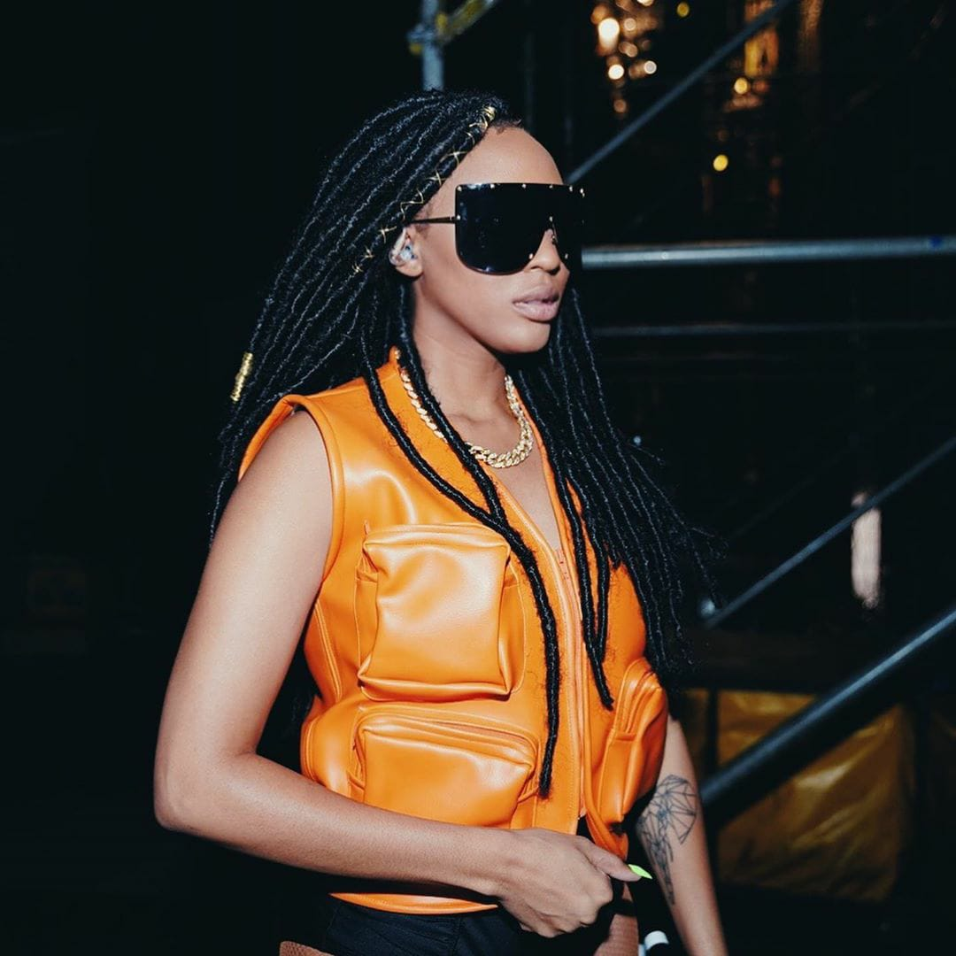
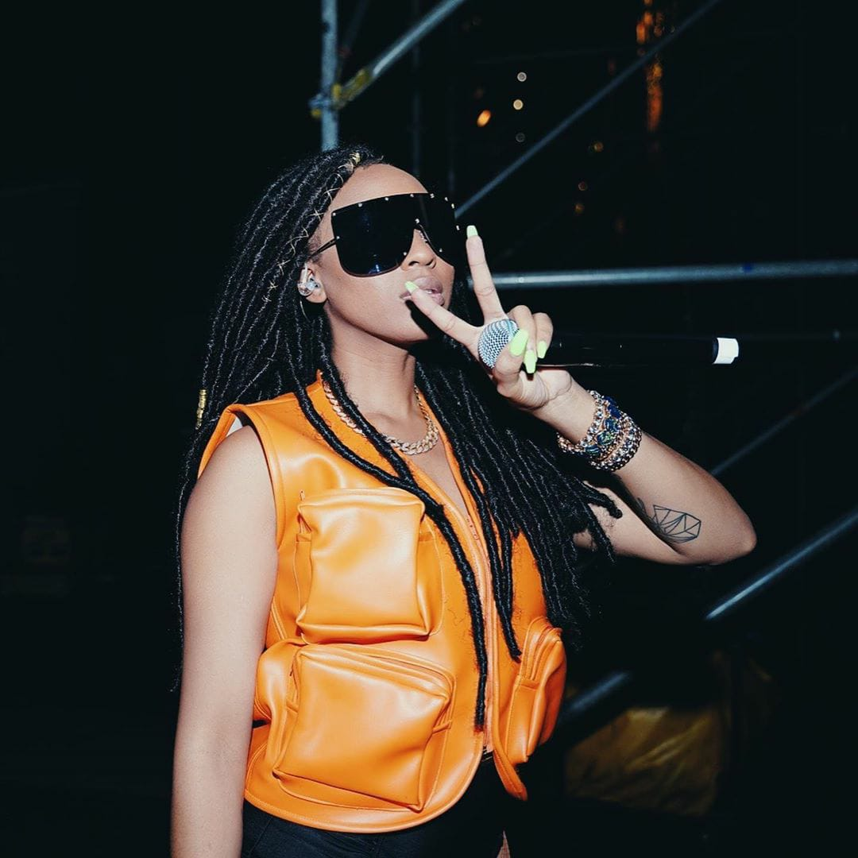
nadianakaiVerified filluproyalbafokeng 🔥🔥🔥🔥 📷 @lashshotsstudios DECEMBER 16, 2019
Her hairstyle is in faux locs, dressed in leather bulletproof top and well accessories. Peace sign hand gesture. Hashtag: #filluproyalbafokeng Mentions: @lashshotsstudios Emojis: flame and camera.

Slide 189
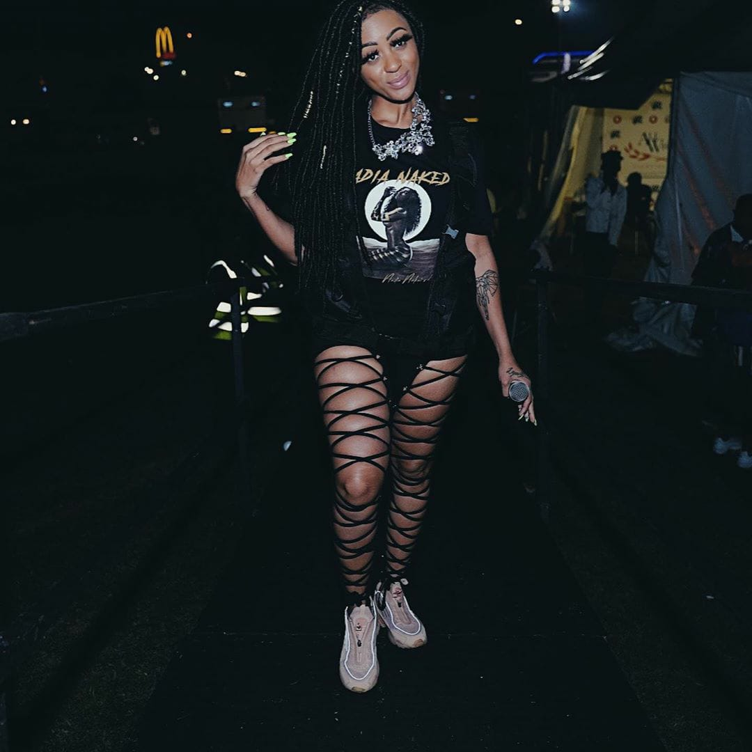
nadianakaiVerified Bragga on the T 👕, Reebok on the feet 🦶, Naked Without make me blink 👁 Yup B, it’s all me! DECEMBER 16, 2019
The artist is posing, walks on a ramp into stage. Dressed in oversized T-shirt, sneakers, strip stockings and neckpiece. Her hair in long faux locs. Words on caption: Bragga on the T , Reebok on the feet , Naked Without make me blink. Brand affiliation: Reebok, Emojis: T-shirt, feet and one eye. Yup B, it’s all me!

Slide 190
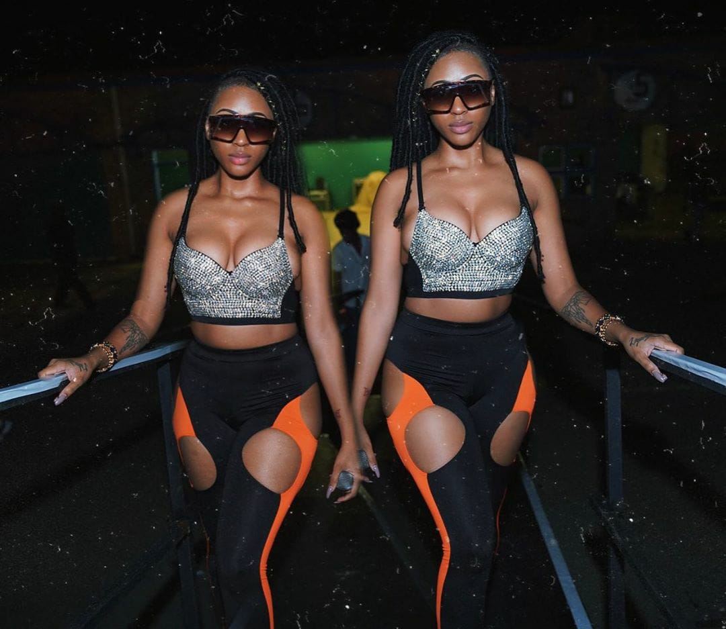
The artist is posing on a stage ramp. Wearing a sparkling bling crop top and long tights, a bracelet and shades. Makeup, long nails and faux locs. Words on caption: Welkom was mad LIT!!!!! Mentions: @lashshotsstudios Emoji: Camera
nadianakaiVerified
Welkom was mad LIT!!!!! 📷 @lashshotsstudios
JANUARY 1, 2020

